Slide 1


From RDMA to SmartNIC
Computer System Principle (2022 Fall)
Xingda Wei
IPADS, Shanghai Jiao Tong University
https://www.sjtu.edu.cn
Credits: Jinwei Xu@IPADS

Slide 2
Networking is a key component in distributed systems
Example: large-scale websites
How each component communicates? Networking!
Caching server
Caching server
Caching server
…
Caching
Caching
Caching
Distributed caching
Database server
Database server
CDN
Users
Application #1
generate the page
Database
user, price
…
Database
user, price
Application server
Distributed database
Internet
Load
Balance
Application #2
add the order
File server
File server
File server
File:
image
File:
image
…
File:
image
Application server
…
…
Message queue
Distributed file system

Slide 3
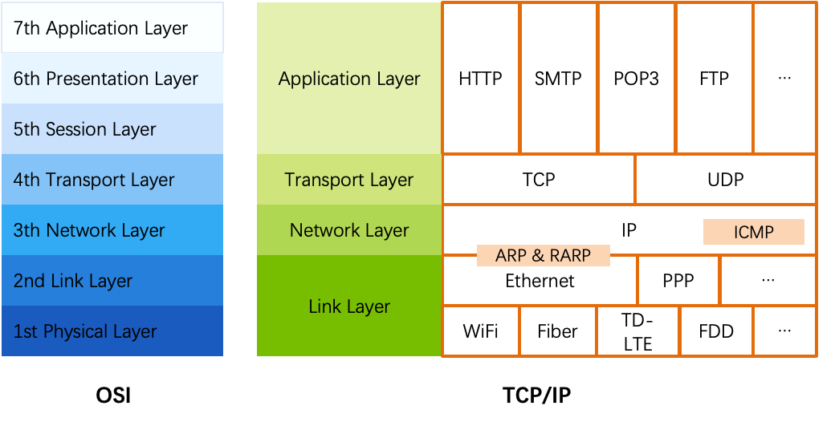
Review: traditional networking
OSI
The open systems interconnection (OSI) model
7-layer architecture

Slide 4
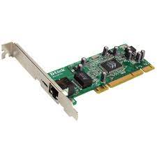

Review: traditional packet processing in Linux
Application
User space
read(), write()
Kernel space
Socket
TCP/IP
Driver
Ring Buffer
Network card
TX/RX queues

Slide 5
Review: Packet processing with DPDK
Application
DPDK
Ring Buffer
User space
Kernel space
Network card
TX/RX queues

Slide 6
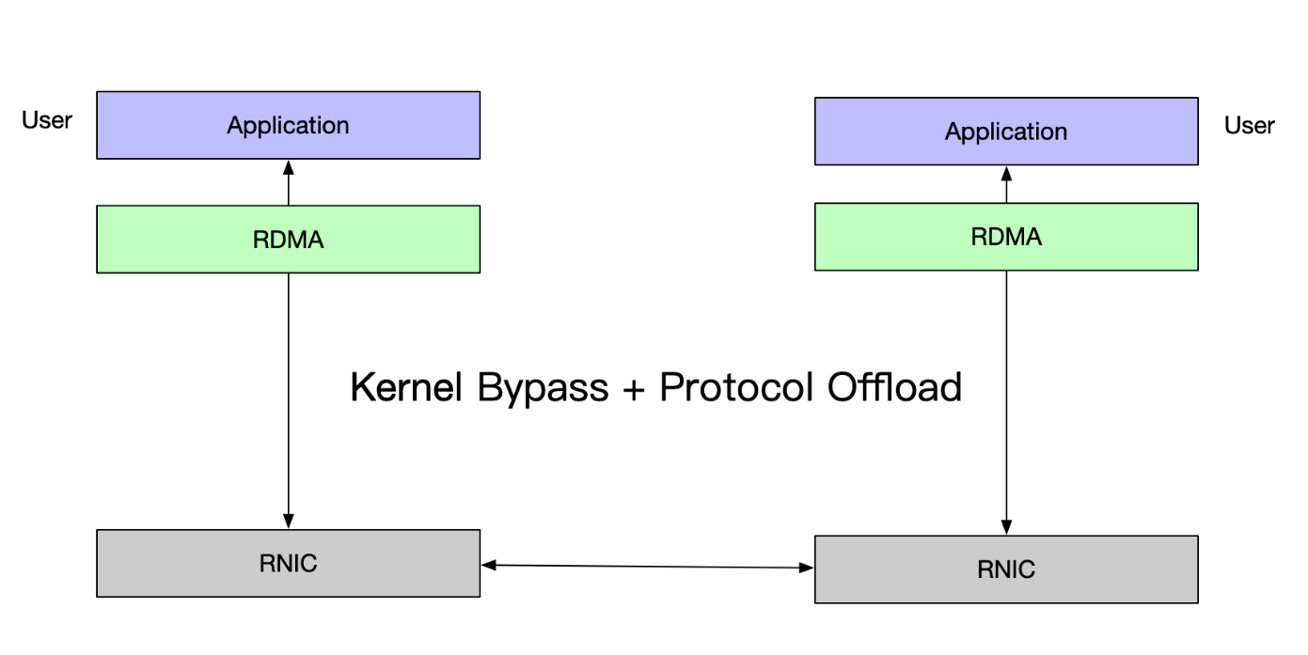
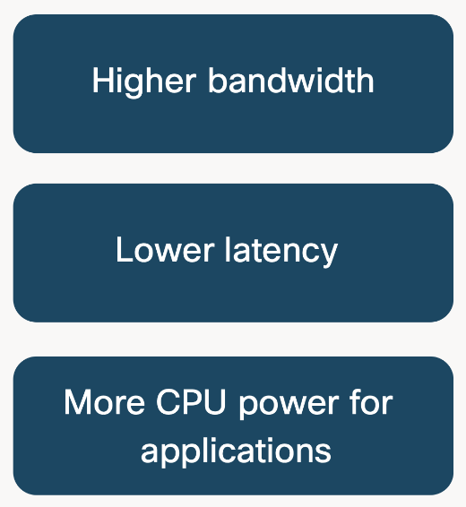
RDMA: offload the complete network stack to the NIC
RDMA = Remote Direct Memory Access
Direct memory-to-memory data communication over network.

Slide 7
Review: High-level concepts of RDMA
Queue Pairs (Send Queue, Complete Queue and Receive Queue)
SQ, CQ & RQ
A group of queues form an RDMA connection
Analog to connections in TCP/IP
User posts networking requests to the SQ
Two-sided: message datagram (like send/recv)
One-sided: remote read/write (will be talked about later)
Get the completion events of the send requests from the CQ
Receive two-sided messages from the RQ

Slide 8
Building high-performance distributed systems w/ RDMA

Slide 9
Case study: distributed in-memory key-value store (KVS)
Key building blocks in distributed systems
E.g., serve as caching
Provide basic PAI for:
Get(K) -> V,
Scan(K,N)
Update(K,V)
Insert(K,V)
Delete(K,V)
Application
generate the web page
Application server
Local area network
Caching server
Caching server
Caching
Caching
Not always needed.
Not the focus of this lecture.
File server
Database server
File:
image
Database
user, price

Slide 10
What is the bottleneck of the such a KV?
A network packet is typically passed through multiple devices
NIC, switch, PCIe, memory
Memached client
Memached client
Memached client
Memached client
RDMA
Memached server
…
Memached client
Memached client

Slide 11
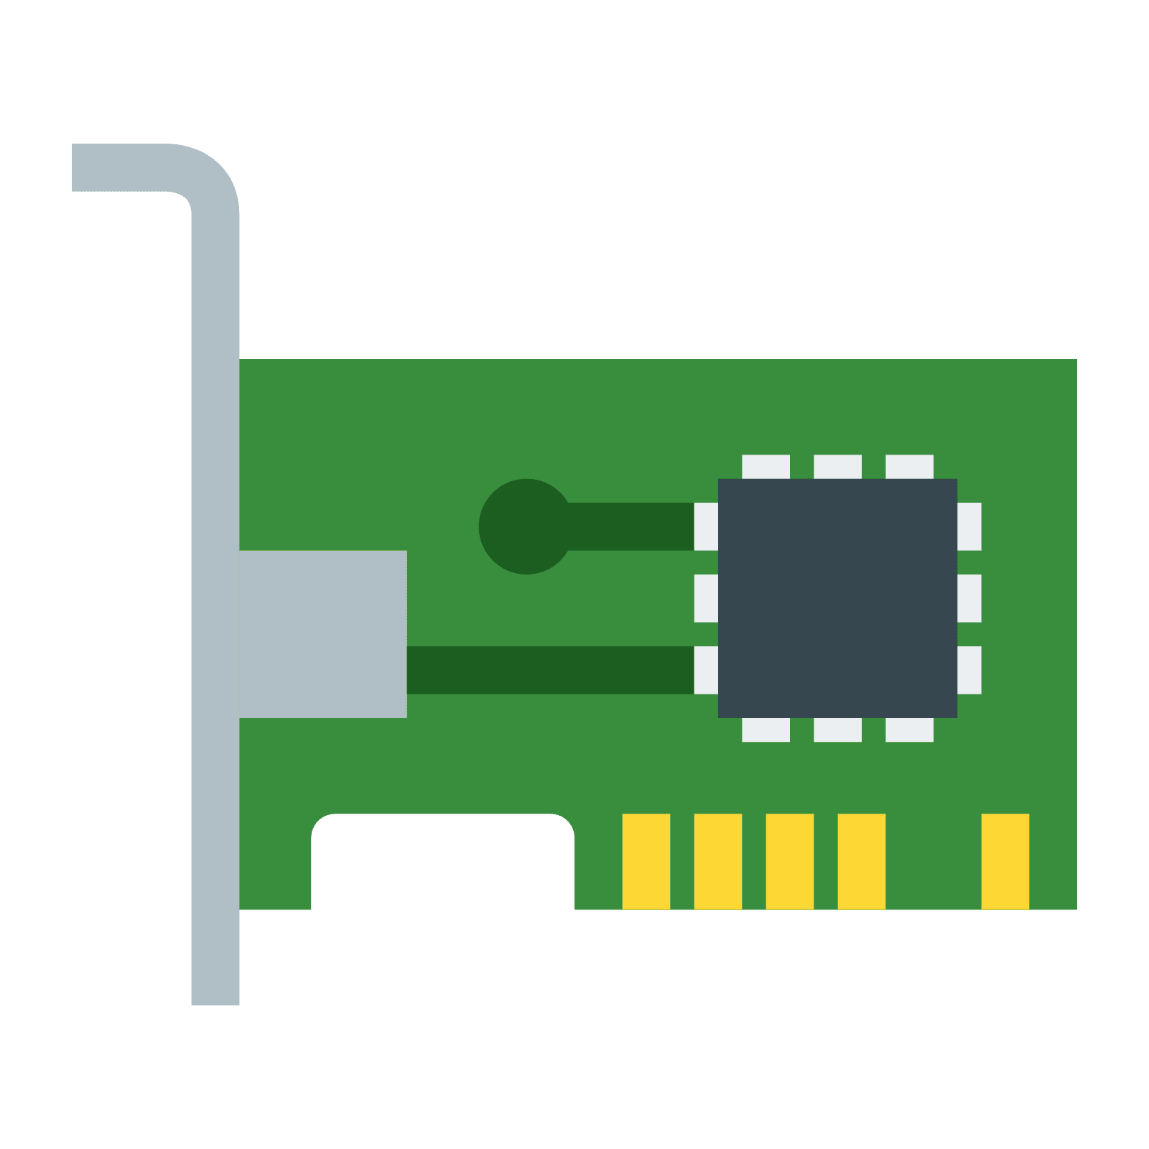



What is the bottleneck of the such a KV?
Assumption
Network card: 100Gbps
Switch: 100Gbps per port
PCIe: PCIe 3.0 X 16 = 128Gbps
Memory bus bandwidth: >= 800Gbps
Clients
Server
Switch
PCIe
Bus
DRAM

Slide 12


What is the limit of a single core for KVS?
Essential operations:
Poll the request
Memory accesses to find the value of the key
Send back the results
Find the value of the key
Poll the request
000
x
x
John Smith
123-456
000
◉
Xingda Wei
◉
Yubin Xia
123-456
152
x
Hash
function
153
◉
x
Xingda Wei
123-456
keys

Slide 13
What is the limit of a single core for KVS?
Poll request & read request: 100ns
Compute the hash function: 1ns
Read hash table: 200-400ns (depends on the length of the list)
Copy the value: 100ns
Send the reply: 200-800ns
Using MMIO
Find the value of the key
600-1400ns!
Poll the request
000
x
x
John Smith
123-456
000
◉
Xingda Wei
◉
Yubin Xia
123-456
152
x
Hash
function
153
◉
x
Xingda Wei
123-456
keys

Slide 14
Single-core limit of two-sided-based RDMA KVS
1 second = 1000,000,000ns
Assume an average 1000ns per KV request
One CPU core can only achieve 1 million requests per-second
A high-end server may only have 10-20 CPU cores
Far gap between CPU & NIC (100 millions)
Even on a single workload: distributed key-value store

Slide 15
Summary: CPU can become the bottleneck of in-memory key-value stores

Slide 16
Note: not a hard conclusion!
Different hardware may yield different performance

Slide 17
Opportunity: using one-sided RDMA
One-sided RDMA
READ
The NIC can directly read the server memory bypassing server CPU
WRITE
The NIC can directly write the server memory bypassing server CPU
ATOMICS (fetch & add, compare & swap)
The NIC can directly execute atomic operations bypassing server CPU
Bypass the CPU bottleneck !

Slide 18
One-sided RDMA-based KVS approach
Basic idea:
Use RDMA READ/WRITE to operate the remote memory like it is local
One-sided RDMA is extremely fast
E.g., a high-end ConnectX-6 NIC (200Gbps) can process
100M 64B READs /sec

Slide 19
One-sided RDMA-based KVS approach: Get(K)
Hash function
keys
Client
Xingda Wei
◉
◉
Yubin Xia
x
Xingda Wei
123-456
One-sided RDMA:
READ (153)
One-sided RDMA:
READ (bucket)
One-sided RDMA:
READ (bucket)
One-sided RDMA:
READ (value)
buckets
entries
000
x
x
John Smith
123-456
000
◉
Server
◉
Yubin Xia
123-456
152
x
153
◉
x
Xingda Wei
123-456

Slide 20
Challenge: network amplification
Hash function
keys
Client
Xingda Wei
◉
◉
Yubin Xia
x
Xingda Wei
123-456
One-sided RDMA:
READ (153)
One-sided RDMA:
READ (bucket)
One-sided RDMA:
READ (bucket)
One-sided RDMA:
READ (value)
Question
How many network RTTs are required for a single KV request?
Problem: Network amplification:
Transfer larger payloads than required
Need more network RTTs than required
Notes:
问题：这里有哪些network amplification？

Slide 21
Challenge: network amplification
Hash function
keys
Client
Xingda Wei
◉
◉
Yubin Xia
x
Xingda Wei
123-456
One-sided RDMA:
READ (153)
One-sided RDMA:
READ (bucket)
One-sided RDMA:
READ (bucket)
One-sided RDMA:
READ (value)
Suppose an RDMA card can support 100M/sec one-sided READs
4 RTTs will degrade the overall performance to 25M/sec
Further: RDMA’s latency is still much higher than local memory accesses!
100 ns vs. 2000--4000ns, so the latency may be higher than the CPU solution

Slide 22
Solution: RDMA-friendly data structures
Traditional linked-list—based hash table essentially faces the problem of many pointer-chasing for KV operations
Question:
Which data structure can we use to improve the performance of RDMA-based in-memory KVS?
Example solution: Cuckoo hashing!

Slide 23
Cuckoo hashing
Buckets0
Buckets1
Cuckoo hashing
Maintain two hash buckets
value
32
16
73
84

Slide 24
Cuckoo hashing
Buckets0
Buckets1
Cuckoo hashing
Maintain two hash buckets
Get()
Using two hash functions H0 & H1
The key must be in Buckets0[H0(key)] or Buckets1[H1(key)]
value
32
16
73
84

Slide 25
Cuckoo hashing
Buckets0
Buckets1
Cuckoo hashing
Maintain two hash buckets
Get()
Using two hash functions H0 & H1
The key must be in Buckets0[H0(key)] or Buckets1[H1(key)]
Example: Get(73)
Buckets0[H0(73)] = 2
value
32
16
73
?
84

Slide 26
Cuckoo hashing
Buckets0
Buckets1
Cuckoo hashing
Maintain two hash buckets
Get()
Using two hash functions H0 & H1
The key must be in Buckets0[H0(key)] or Buckets1[H1(key)]
Example: Get(73)
Buckets0[H0(73)] = 2 & Buckets1[H1(k73)] = 1
value
32
16
73
84

Slide 27
Cuckoo hashing
Buckets0
Buckets1
Cuckoo hashing
Maintain two hash buckets
Put()
Similar as Get()
1. find the bucket
2. update the value
value
32
16
73
84
What about insert?

Slide 28
Cuckoo hashing
Buckets0
Buckets1
Cuckoo hashing
Maintain two hash buckets
Insert()
Much complicated: should insert to Buckets0[H0(key)] or Buckets1[H1(key)]
Question: what if no available space?
value
32
16
73
84

Slide 29
Cuckoo hashing
Buckets0
Buckets1
Cuckoo hashing
Maintain two hash buckets
Insert()
Much complicated: should insert to Buckets0[H0(key)] or Buckets1[H1(key)]
Example: Insert(2)
Buckets0[H0(2)] = 0 & Buckets1[H1(2)] = 0
value
32
16
73
84

Slide 30
Cuckoo hashing
Can we insert here?
Buckets0
Buckets1
Cuckoo hashing
Maintain two hash buckets
Insert()
Much complicated: should insert to Buckets0[H0(key)] or Buckets1[H1(key)]
Example: Insert(2)
Buckets0[H0(2)] = 0 & Buckets1[H1(2)] = 0
value
32
16
73
84

Slide 31
Cuckoo hashing
Buckets0
Buckets1
Cuckoo hashing
Maintain two hash buckets
Insert()
Much complicated: should insert to Buckets0[H0(key)] or Buckets1[H1(key)]
Example: Insert(2)
Buckets0[H0(2)] = 0 & Buckets1[H1(2)] = 0
Insert here!
value
32
2
16
73
84

Slide 32
Cuckoo hashing
Buckets0
Buckets1
Cuckoo hashing
Maintain two hash buckets
Insert()
Much complicated: should insert to Buckets0[H0(key)] or Buckets1[H1(key)]
Example: Insert(9)
Buckets0[H0(9)] = 0 & Buckets1[H1(9)] = 0
value
32
2
16
73
84

Slide 33
Cuckoo hashing
Both slots are not empty!
Buckets0
Buckets1
Cuckoo hashing
Maintain two hash buckets
Insert()
Much complicated: should insert to Buckets0[H0(key)] or Buckets1[H1(key)]
Example: Insert(9)
Buckets0[H0(9)] = 0 & Buckets1[H1(9)] = 0
value
32
2
16
73
84

Slide 34
Cuckoo hashing
Buckets0
Buckets1
Cuckoo hashing
Maintain two hash buckets
Insert()
Much complicated: should insert to Buckets0[H0(key)] or Buckets1[H1(key)]
Example: Insert(9)
Buckets0[H0(9)] = 0 & Buckets1[H1(9)] = 0
Cuckoo hashing will kick others to different place to empty
value
32
2
16
73
84

Slide 35
Cuckoo hashing
Can insert 9 here!
Buckets0
Buckets1
Cuckoo hashing
Maintain two hash buckets
Insert()
Much complicated: should insert to Buckets0[H0(key)] or Buckets1[H1(key)]
Example: Insert(9)
Buckets0[H0(9)] = 0 & Buckets1[H1(9)] = 0
Cuckoo hashing will kick others to different place to empty
Kick 32 (Buckets0[0]) to another place
Assume: H1(32) = 2
9
2
16
73
32
84
value

Slide 36
Cuckoo hashing
Buckets0
Buckets1
Buckets0
Buckets1
Buckets0
Buckets1
32
2
2
9
2
16
73
16
73
16
73
32
32
84
84
84
Insert(9)
Kick(32)
Buckets0[H0(9)] = 0
& Buckets1[H1(9)] = 0
H1(32) = 2
Question: what if H1(32) = 3? (which is taken by 84)

Slide 37
Cuckoo hashing
Buckets0
Buckets1
Cuckoo hashing
Maintain two hash buckets
Insert()
Much complicated: should insert to Buckets0[H0(key)] or Buckets1[H1(key)]
Example: Insert(9)
Buckets0[H0(9)] = 0 & Buckets1[H1(9)] = 0
Cuckoo hashing will kick others to different place to empty
Kick 32 (Buckets0[0]) to another place
Question: what if H1(32) = 2 = 3?
32
2
16
73
84
value

Slide 38
Cuckoo hashing
Buckets0
Buckets1
Cuckoo hashing
Maintain two hash buckets
Insert()
Much complicated: should insert to Buckets0[H0(key)] or Buckets1[H1(key)]
Example: Insert(9)
Buckets0[H0(9)] = 0 & Buckets1[H1(9)] = 0
Cuckoo hashing will kick others to different place to empty
Kick 32 (Buckets0[0]) to another place
Kick 2 (Buckets1[0]) to another place
9
2
16
73
84
value

Slide 39
Cuckoo hashing
Buckets0
Buckets1
Cuckoo hashing
Maintain two hash buckets
Insert()
Much complicated: should insert to Buckets0[H0(key)] or Buckets1[H1(key)]
Example: Insert(9)
Buckets0[H0(9)] = 0 & Buckets1[H1(9)] = 0
Cuckoo hashing will kick others to different place to empty
Kick 2 (Buckets1[0]) to another place
Assume: H0(2) = 2
32
9
16
73
2
84
value

Slide 40
Cuckoo hashing
No available slots!
Buckets0
Buckets1
Cuckoo hashing
Maintain two hash buckets
Insert()
Much complicated: should insert to Buckets0[H0(key)] or Buckets1[H1(key)]
Example: Insert(9)
Buckets0[H0(9)] = 0 & Buckets1[H1(9)] = 0
Cuckoo hashing will kick others to different place to empty
Kick 2 (Buckets1[0]) to another place
Assume: H0(2) = 2 1 What if that happens?
32
2
16
73
84
value

Slide 41
Cuckoo hashing
Buckets0
Buckets1
Cuckoo hashing
Maintain two hash buckets
Insert()
Much complicated: should insert to Buckets0[H0(key)] or Buckets1[H1(key)]
If no available slots, rehashing & repeat the above insert process
Rehashing: enlarge the buckets (typically X2)

Slide 42
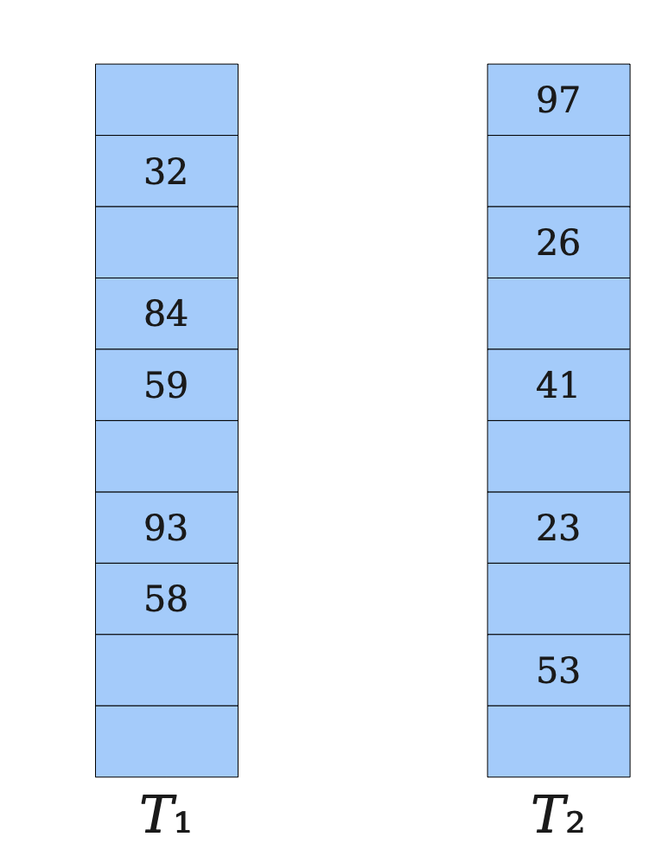
Cuckoo hashing
Cuckoo hashing
Two tables & Two hash functions (H₁, H₂)
The key can only at T₁[H₂(key)] or T₂[H₂(key)]
Pros
Good for read: at most two 2 random I/O for get
Cons
Insertion is complex and can issue many random disk I/O
Rehashing is required if there are many insertions, which is extremely slow
Expanding the table, and re-insert all the keys in the new table (!)
Notes:
We will not cover many details

Slide 43
Cuckoo hashing is an RDMA-friendly data structure
Cuckoo hashing
Two tables & Two hash functions (H₁, H₂)
The key can only at T₁[H₂(key)] or T₂[H₂(key)]
Get only needs at most 3RTTs to finish
Much complicated for insertion
Kicking KV to different buckets upon hash collisions
We will talk about it later

Slide 44
Get(K) with cuckoo hashing
buckets
entries
000
John Smith
123-456
000
Server
152
Yubin Xia
123-456
153
Xingda Wei
123-456

Slide 45
Get(K) with cuckoo hashing
keys
Client
Xingda Wei
Hash function 0
Xingda Wei
123-456
One-sided RDMA:
READ (153)
One-sided RDMA:
READ (value)
buckets
entries
000
John Smith
123-456
000
Server
152
Yubin Xia
123-456
153
Xingda Wei
123-456

Slide 46
Drawbacks of Cuckoo hashing
Extra RTTs for lookup in case of hash collision
Observation
RDMA has similar performance of larger reads as small reads
Why? Hardware has a fixed granularity for access,
E.g., PCIe uses 64B
The NIC processing overhead may dominate for "not so large” messages

Slide 47
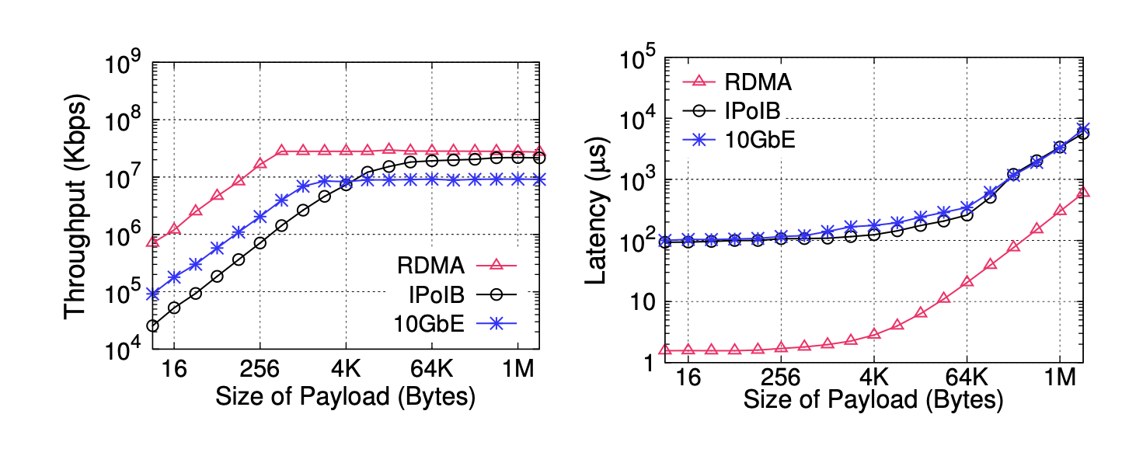
Performance characteristics of RDMA

Slide 48
Idea: use large buckets to reduce hash collision
Buckets0
Buckets1
Suppose we want to insert key 9
H0(9) = 0
Normal cuckoo hashing
Insert to buckets 1
Meaning another RDMA RTT for Get(9)
Solution: store an overflow slot at each bucket
Reduce the probability of hash collision
At the cost of extra space
At the cost of extra lookup (trivial)
32
16
73
84
Buckets0
Buckets1
32
16
73
84

Slide 49
Short-summary of RDMA-based data structures
Existing RDMA-based KVS adopt two design decisions
Customized hash data structure
Pliaf@ATC’13 (Cuckoo hashing)
FaRM-KV@NSDI’14 (Hopscotch hashing)
Large buckets that suits RDMA
FaRM-KV uses 6 entries per read
DrTM-KV@SOSP’15 (cluster chaining, a configurable number of entries per-bucket)

Slide 50
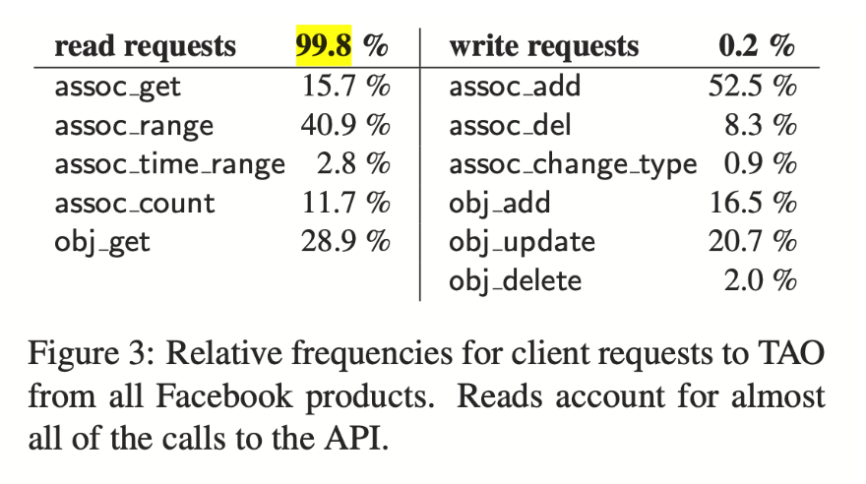

What about put?
Much complicated than the Get()
Kicking entries in case of multiple hash collisions
Re-construct the hash table in case of rehashing
Solution: hybrid approach
Use RPC for the put operations
Only use RDMA for get Get()
Observation
Read-only dominates the real workload [1]
[1] Tao: Facebook’s distributed data store for the social graph. ATC’13

Slide 51
Challenge: read/write between different devices

Slide 52
Running put & get concurrently at different devices
keys
Client
Xingda Wei
Hash function 0
Xingda Wei
One-sided RDMA:
READ (153)
buckets
entries
Server CPU
000
John Smith
123-456
000
152
Yubin Xia
123-456
153
Xingda Wei
123-456

Slide 53
Running put & get concurrently at different devices
keys
Client
Xingda Wei
Hash function 0
Xingda Wei
One-sided RDMA:
READ (153)
buckets
entries
Server CPU
000
John Smith
123-456
Put(Wei Xingda)
Hash(Wei Xingda) = 153
000
152
Yubin Xia
123-456
153
Xingda Wei
123-456

Slide 54
Running put & get concurrently at different devices
keys
Client
Xingda Wei
Hash function 0
Xingda Wei
One-sided RDMA:
READ (153)
buckets
entries
Server CPU
000
John Smith
123-456
Put(Wei Xingda, xxx)
Hash(Wei Xingda) = 153
001
Xingda Wei
123-456
152
Yubin Xia
123-456
153

Slide 55
Running put & get concurrently at different devices
keys
Client
Xingda Wei
Hash function 0
Xingda Wei
One-sided RDMA:
READ (153)
buckets
entries
Server CPU
000
John Smith
123-456
Put(Wei Xingda, xxx)
Hash(Wei Xingda) = 153
001
Xingda Wei
123-456
152
Yubin Xia
123-456
153
Wei Xingda
xxx

Slide 56
Running put & get concurrently at different devices
keys
Client
Xingda Wei
Hash function 0
Xingda Wei
xxx
One-sided RDMA:
READ (153)
One-sided RDMA:
READ (value)
Inconsistent!
buckets
entries
Server CPU
000
John Smith
123-456
Put(Wei Xingda, xxx)
Hash(Wei Xingda) = 153
001
Xingda Wei
123-456
152
Yubin Xia
123-456
153
Wei Xingda
xxx

Slide 57
Tradition solution #1: locking?
The simplest solution: spinlock
uint64_t lock = 0;
fn lock_cpu() {
while True {
if CPU_CAS(&mut lock, 0, 1) {
return;
}
}
}
uint64_t addr = 0; // &lock
fn lock_cpu() {
while True {
if RDMA_CAS(addr, 0, 1) {
return;
}
}
}

Slide 58
Problem #1: Extra roundtrips
Client
Xingda Wei
123-456
RDMA
CAS
RDMA
WRITE
Lock
Read bucket
Read value
Unlock

Slide 59
Problem #2: ATOMIC issues between RDMA & CPU
RDMA & CPU uses different atomic implementations
NIC & CPU uses separate locking to ensure atomicity (on its perspective)
NIC: acquire the NIC’s internal lock for atomics
CPU: lock the memory bus for atomics
Thus, RDMA CAS may misses the updates of a CPU CAS!

Slide 60

Traditional solution #2: lock-free read?
Basic idea (similar to OCC)
First read without protection
Check to ensure the read content has unchanged
High-level procedure of Insert upon modifying a bucket
Lock the bucket
Do the insertion
Increase the version
Unlock the bucket
Bucket
1
Yubin Xia
123-456
Lock
Version
Key
Value

Slide 61
Traditional solution #2: lock-free read?
High-level procedure of READ
Read the bucket version & key & lock (assume atomic)
Retry if the lock is held
Read the bucket value
Re-read the bucket version and lock
Retry (1) if the version doesn’t match or lock is held
Similar to the validation in OCC
Bucket
1
Yubin Xia
123-456
Lock
Version
Key
Value

Slide 62
Lock-free READ in RDMA-based KVS
keys
Client
Xingda Wei
Hash function 0
1
Xingda Wei
xxx
One-sided RDMA:
READ (153)
buckets
entries
Server CPU
000
1
John Smith
123-456
001
1
152
1
Yubin Xia
123-456
153
1
Xingda Wei
123-456

Slide 63
Lock-free READ in RDMA-based KVS
keys
Client
Xingda Wei
Hash function 0
1
Xingda Wei
xxx
One-sided RDMA:
READ (153)
buckets
entries
Server CPU
000
1
John Smith
123-456
Put(Wei Xingda, xxx)
Hash(Wei Xingda) = 153
001
1
Xingda Wei
123-456
152
1
Yubin Xia
123-456
153
2
Wei Xingda
xxx

Slide 64
Lock-free READ in RDMA-based KVS
keys
Client
Xingda Wei
Hash function 0
1
Xingda Wei
xxx
One-sided RDMA:
READ (153)
One-sided RDMA:
READ (153)
buckets
entries
Server CPU
000
1
John Smith
123-456
Put(Wei Xingda, xxx)
Hash(Wei Xingda) = 153
001
1
Xingda Wei
123-456
152
1
Yubin Xia
123-456
153
2
Wei Xingda
xxx

Slide 65
Lock-free READ in RDMA-based KVS
keys
Client
Xingda Wei
Hash function 0
xxx
2
Retry…
1
Xingda Wei
One-sided RDMA:
READ (153)
One-sided RDMA:
READ (153)
One-sided RDMA:
READ (153)
buckets
entries
Server CPU
000
1
John Smith
123-456
Put(Wei Xingda, xxx)
Hash(Wei Xingda) = 153
001
1
Xingda Wei
123-456
152
1
Yubin Xia
123-456
153
2
Wei Xingda
xxx

Slide 66
Problem still: Extra roundtrips
keys
Client
Xingda Wei
Hash function 0
xxx
2
Retry…
1
Xingda Wei
One-sided RDMA:
READ (153)
One-sided RDMA:
READ (153)
One-sided RDMA:
READ (153)
Single-machine solution not fit well

Slide 67
Self-verify data structure
Goal: detect incorrect data structure accesses due to read/write races
Without issuing more network RTTs
E.g., lock or read validations
Idea:
Use some kind of checksum to ensure the integrity of the data
i.e., the value belong to the value
Bucket
Yubin Xia
123-456
C
Lock
Key
Value
Checksum

Slide 68
Not an ending story
The story of RDMA-friendly data structure is not an end
Currently, we only show hash-table-based design
What about B+Tree? An open problem to discover
RDMA is also not an end
One-sided primitives, though simple, has been proved powerful
What about more powerful primitives?
E.g., SmartNICs

Slide 69
Understanding the implementation details of RDMA matters

Slide 70
One-sided RDMA primitive seems simple
The network card can read/write server memory
Is that simple?

Slide 71
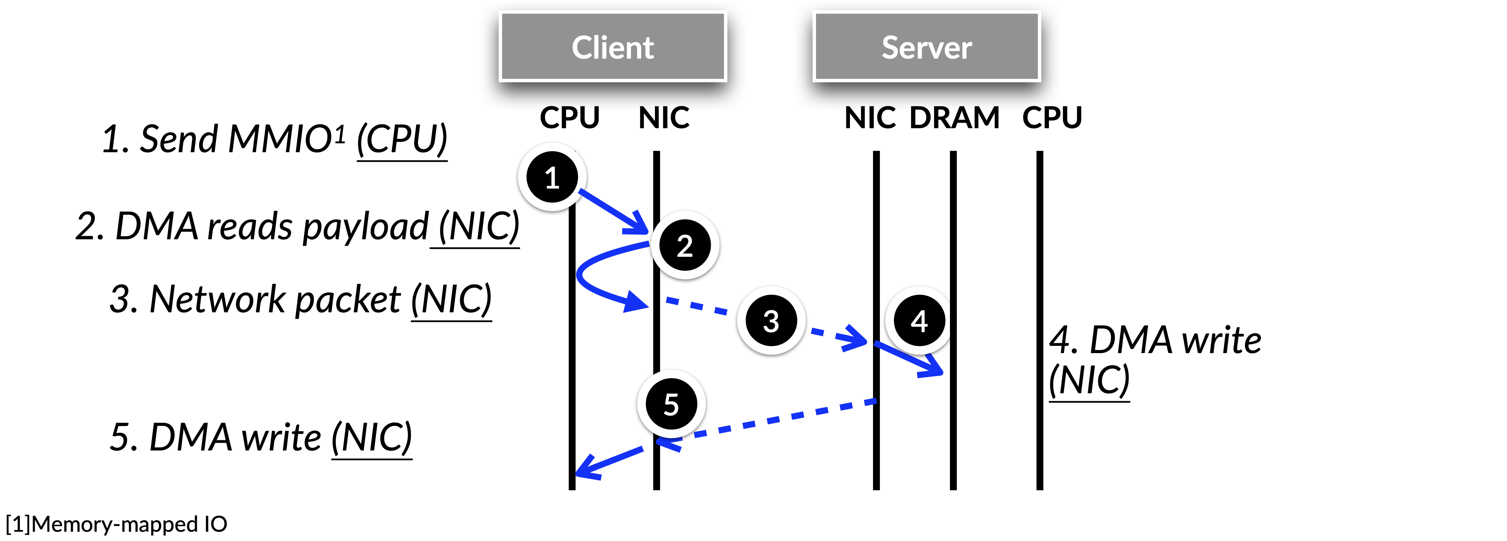
Life cycle of an RDMA one-sided WRITE
[1] Memory-mapped IO

Slide 72
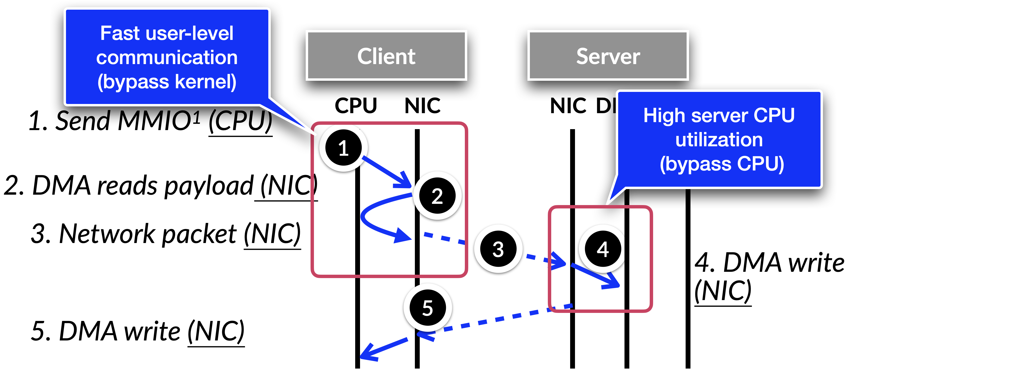
Life cycle of an RDMA one-sided WRITE
Why efficient?
[1] Memory-mapped IO

Slide 73
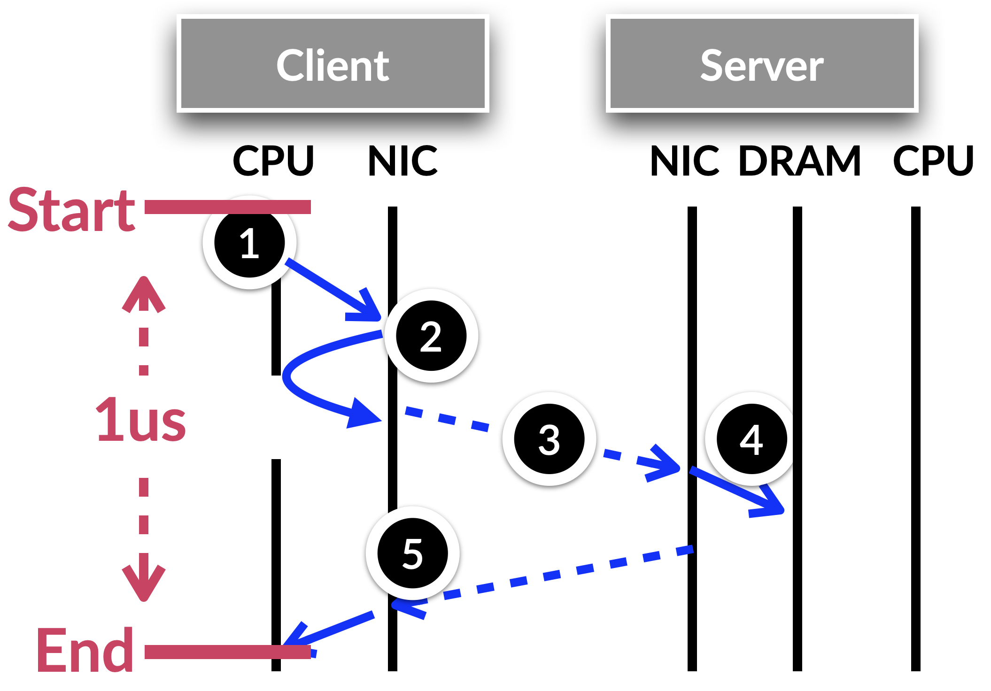
What are the costs in a one-sided WRITE?
The network latency is still high!
At least 1us
Hard to hide due to hardware, network delay, etc.
Suppose we post RDMA requests in a synchronous way
A single core can only achieve 1M reqs/sec
On the other hand, RDMA can achieve 10-100M reqs/sec!

Slide 74
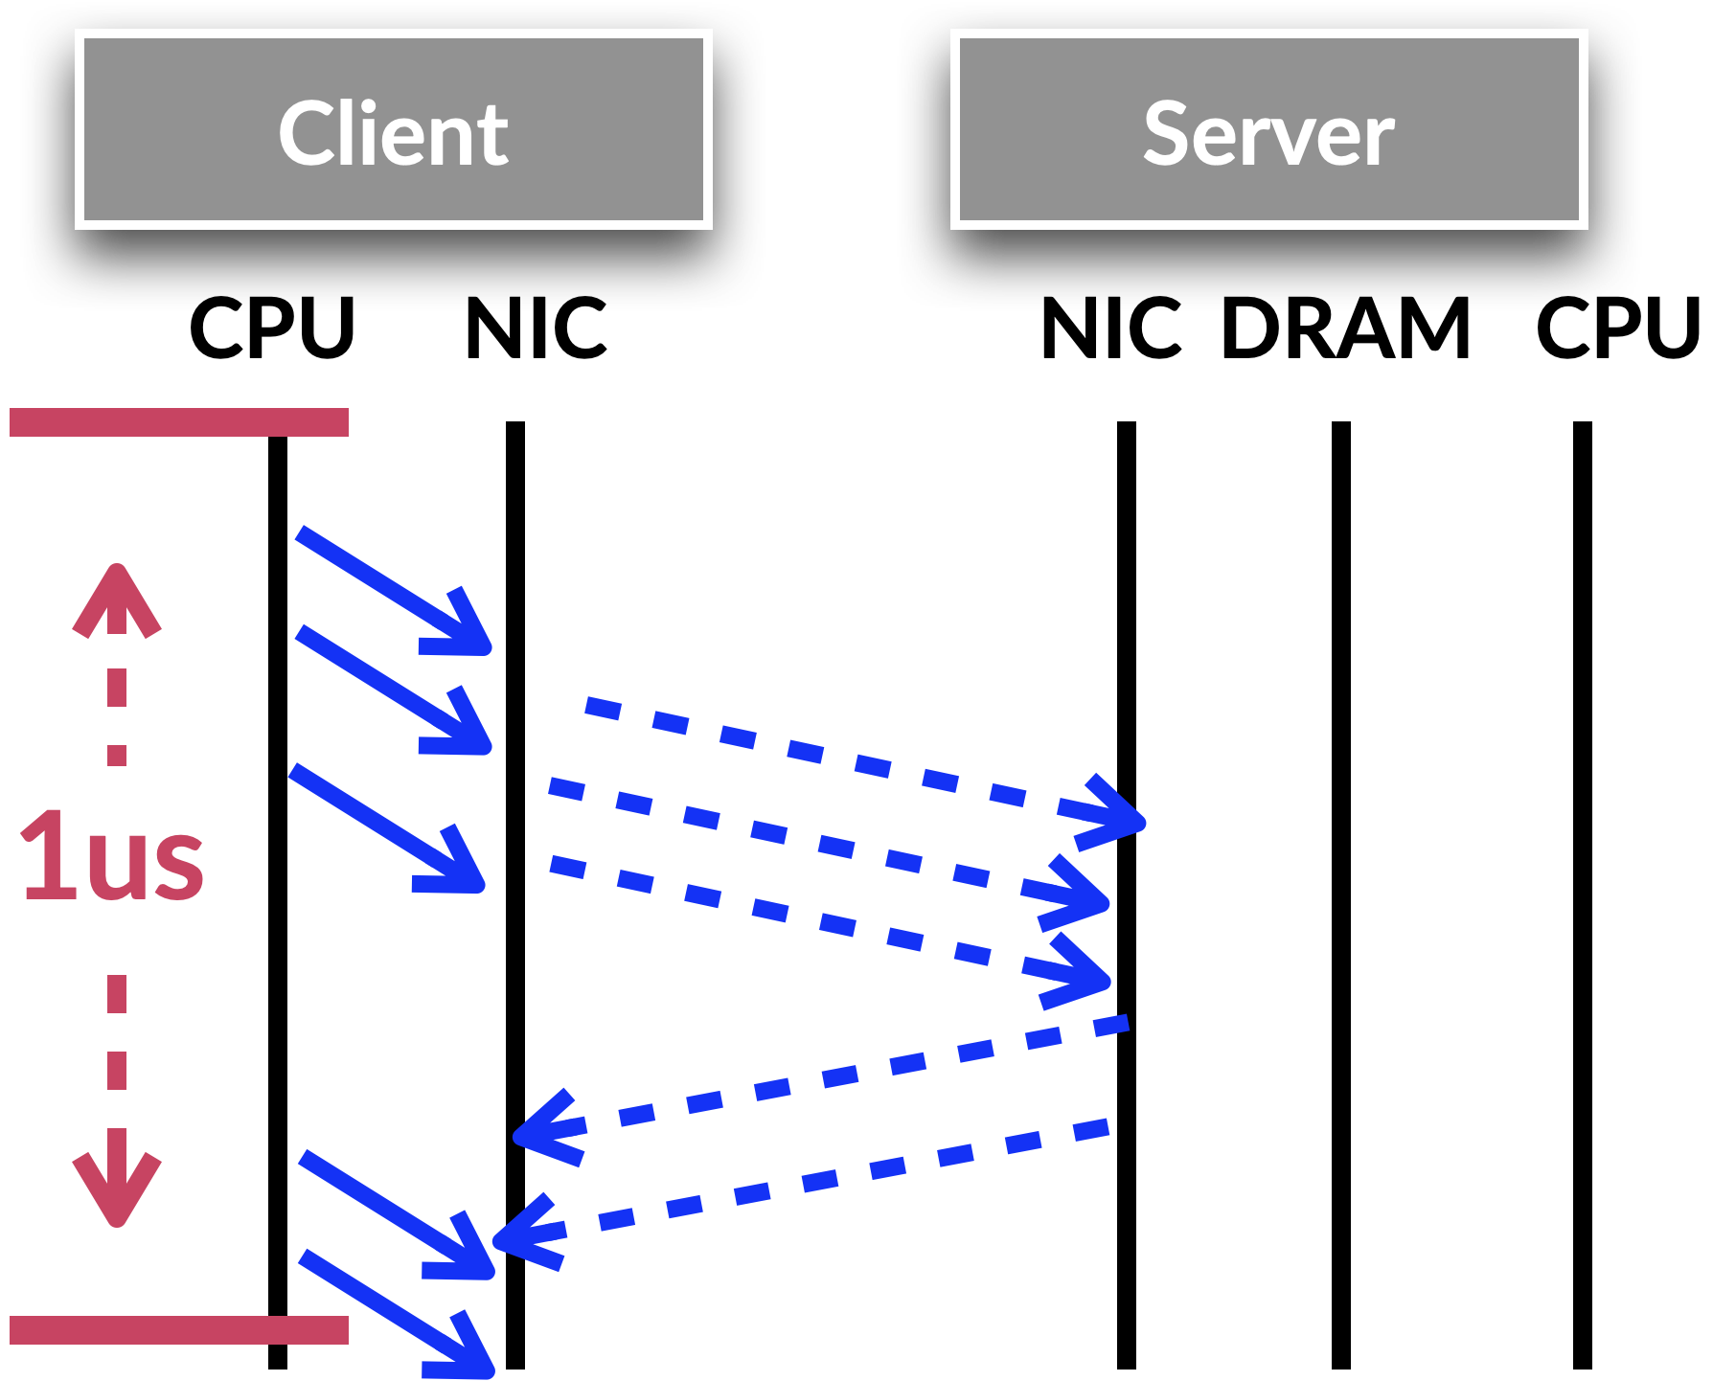
How to avoid waiting? Add more concurrency
Outstanding request & coroutine
Outstanding requests means keep multiple RDMA requests on-the-fly
Coroutine is the same as traditional asynchronous I/O programming
Yield after posting a request
Goal:
Hide polling latency

Slide 75
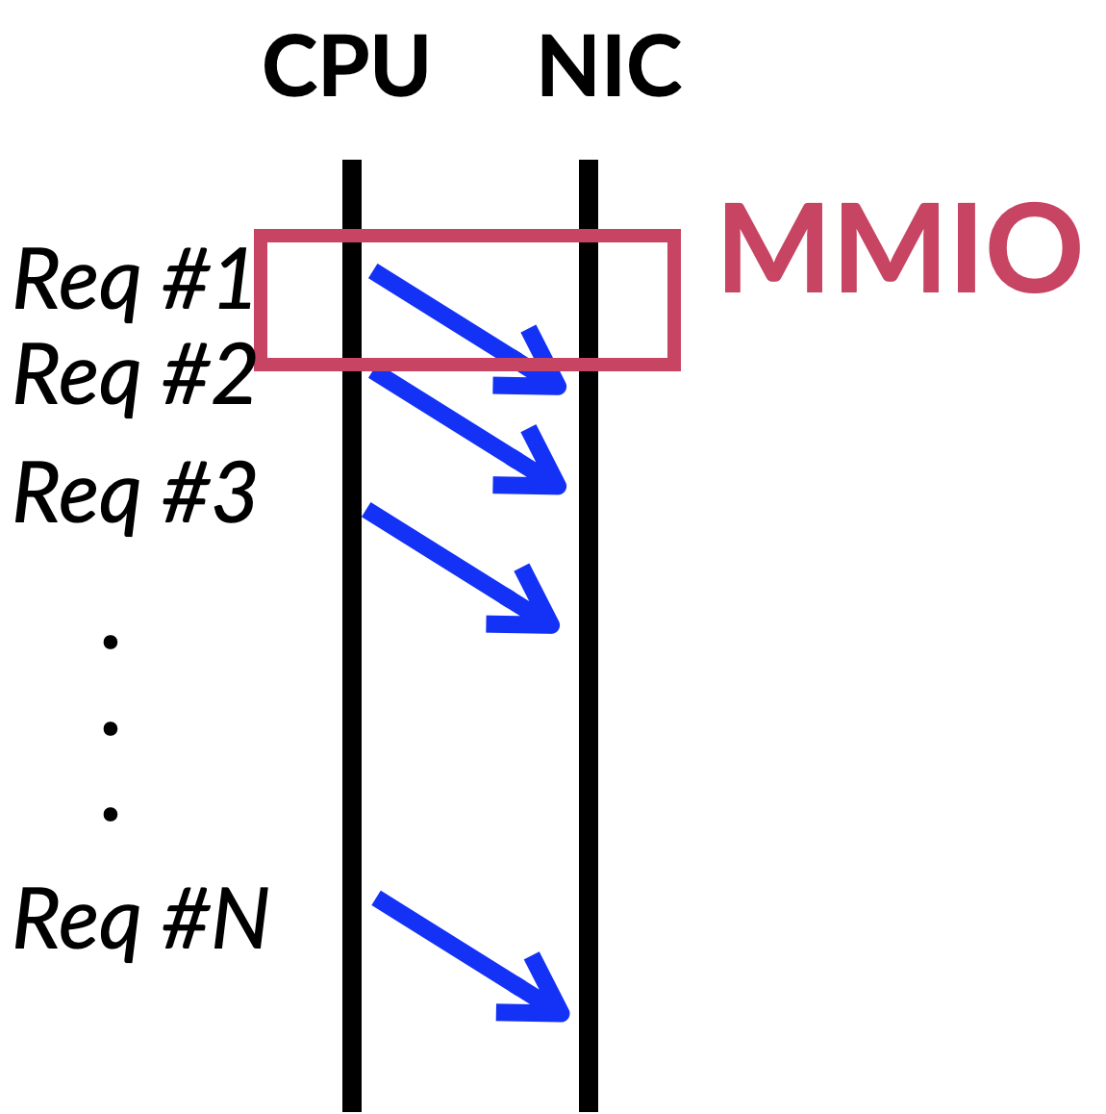
Other costs: MMIO
There are several ways to keep multiple requests on-flight
The common way is to use one MMIO per request
MMIO is (relatively) costly
400 ~ 1000 cycles

Slide 76
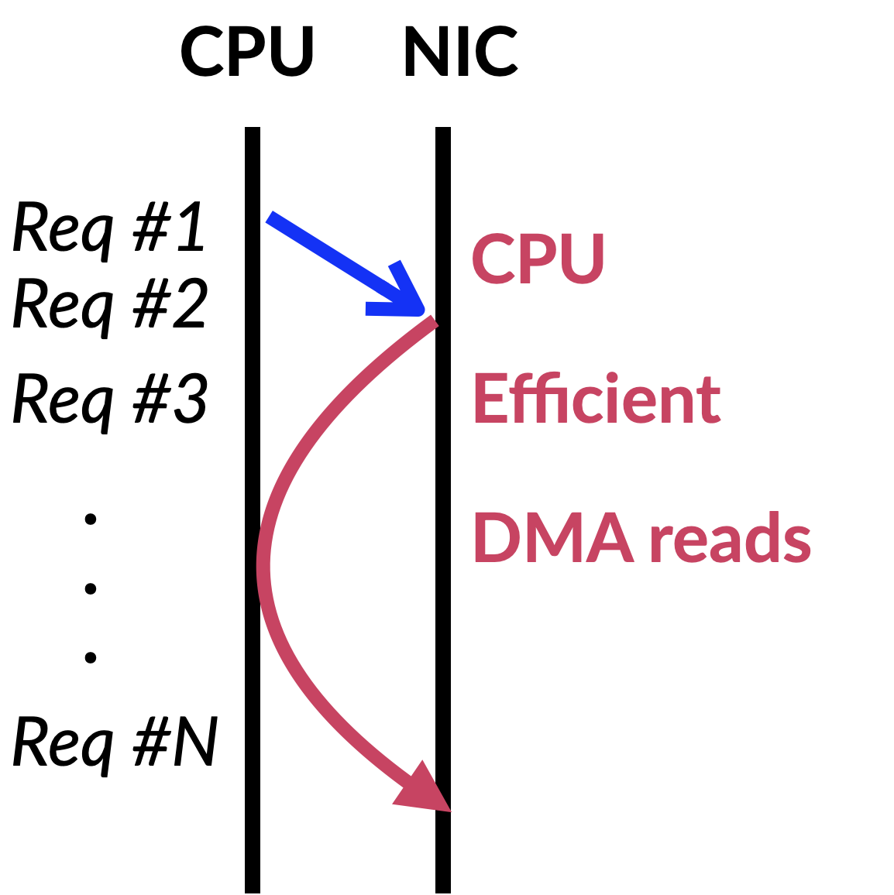
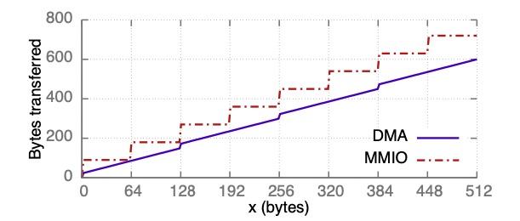
Optimization: doorbell batching
There are several ways to keep multiple requests on-flight
The common way is to use one MMIO per request
MMIO is (relatively) costly
400 ~ 1000 cycles
Doorbell batching:
one MMIO to post a batch of requests, NIC uses
DMA to read them
Credits: Anuj Kalia

Slide 77
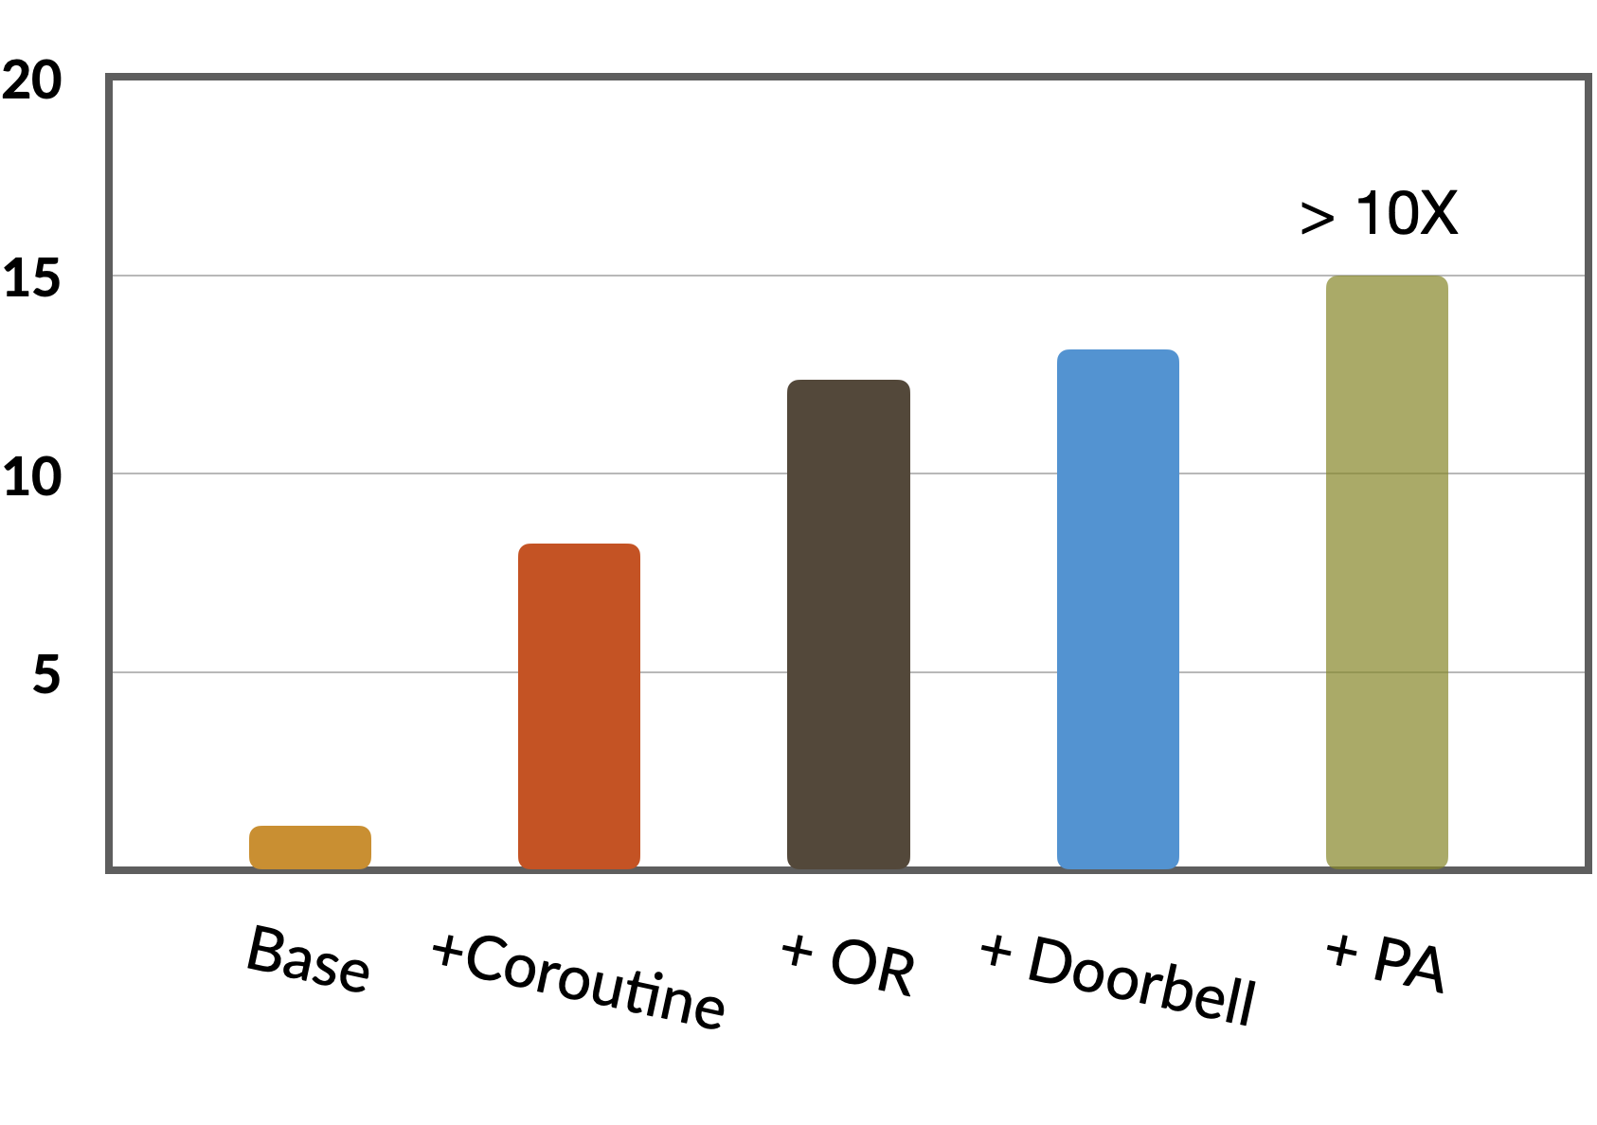
Effects of optimizations
Multiple 64-byte object read micro-benchmark
Passive Ack (PA): omit the ack of the request
Throughput (millon reqs/second)

Slide 78
More about RDMA details

Slide 79
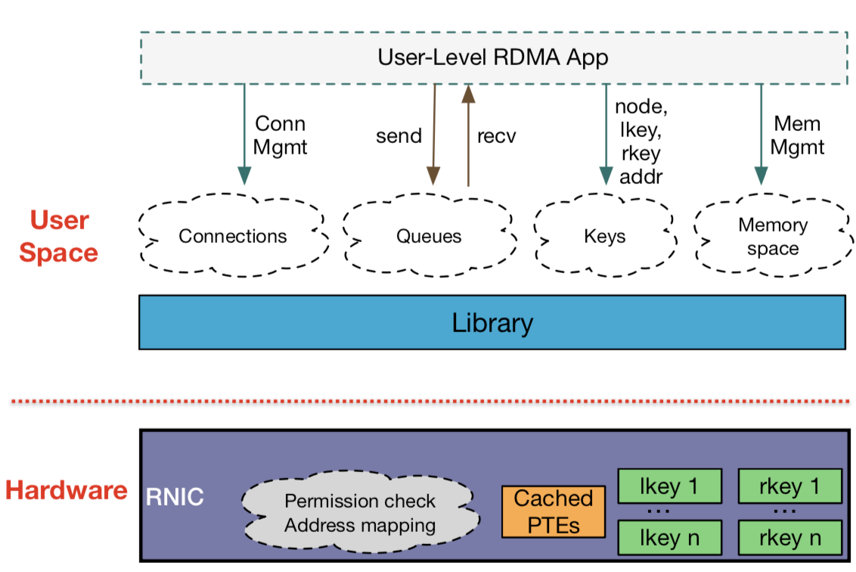
More about RDMA details

Slide 80
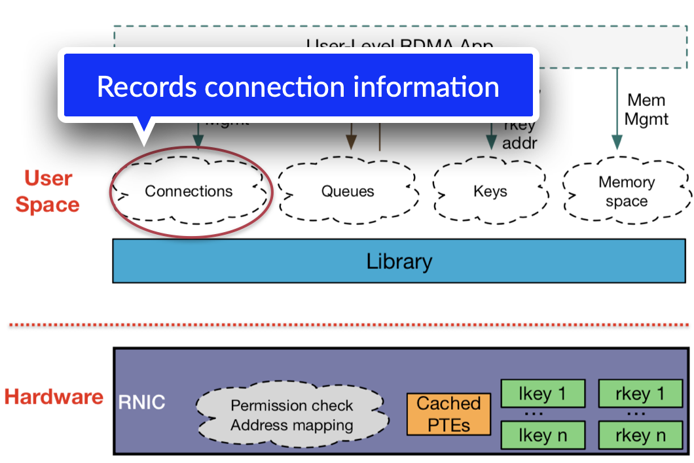

Slide 81
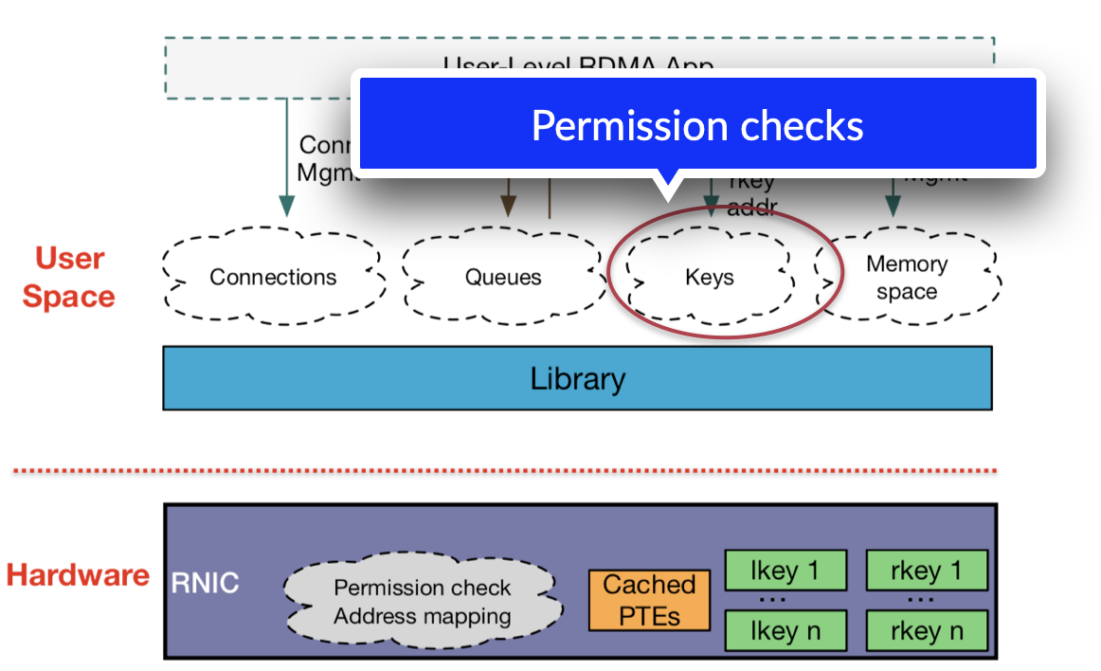

Slide 82
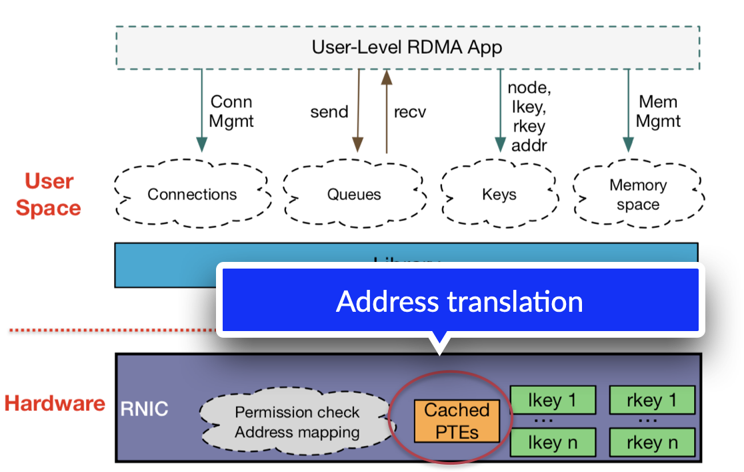

Slide 83
RDMA: out memory design
Connection, translation, permissions, etc. information are stored on the host memory
NIC only caches them in its SRAM
However, NIC has limited SRAM!
Even high-end NIC today has 2MB buffer (ConnectX-5)

Slide 84
RDMA: out memory design
Connection, translation, permissions, etc. information are stored on the host memory
NIC only caches them in its SRAM
However, NIC has limited SRAM!
Even high-end NIC today has 2MB buffer (ConnectX-5)
What if the NIC cache misses?
Use PCIe read to fetch them

Slide 85
RDMA: out memory design
Connection, translation, permissions, etc. information are stored on the host memory
NIC only caches them in its SRAM
However, NIC has limited SRAM!
Even high-end NIC today has 2MB buffer (ConnectX-5)
What if the NIC cache misses?
Use PCIe read to fetch them
Compete DMA w/ normal requests!

Slide 86
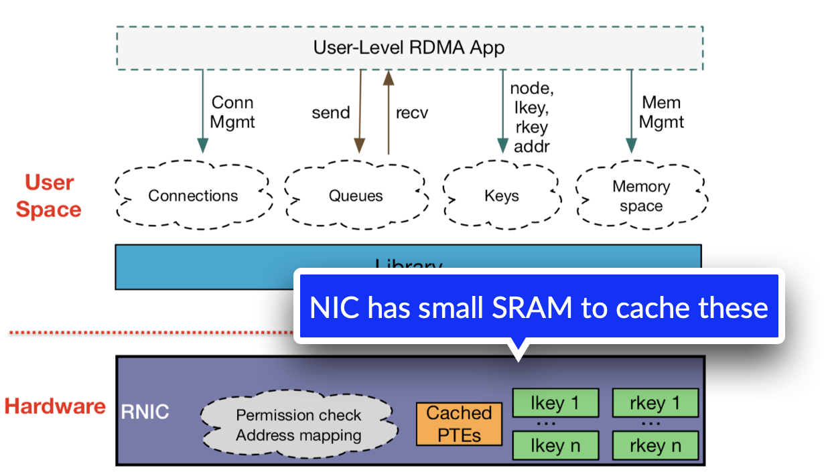

Slide 87
RDMA: out memory design makes cache miss costly
Driver stores these at the host memory
NIC caches a portion of such information
Fetch miss items using PCIe read
~ 1us additional latency, fetch from DRAM using PCIe read
For comparison, RDMA one-sided read takes ~2us

Slide 88
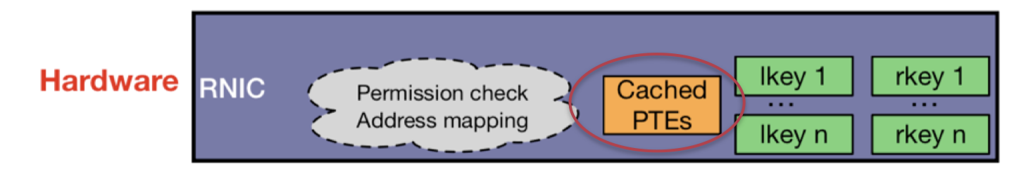
Some can be mitigated, some can not
FaRM@NSDI’14 uses huge page (2MB page instead of 4KB page)
Reduce #PTE entries
E.g., 1GB memory only requires 2048 PTE entries, while 4KB needs 250,000 entries

Slide 89
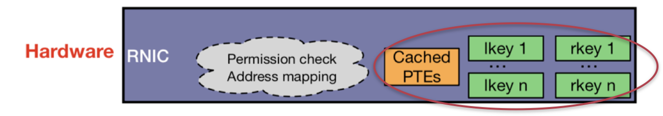
Some can be mitigated, some can not
LITE@SOSP’17 takes to another extreme; it directly physical memory, and uses kernel for security check
No PTE and keys need to be cached at the NIC!

Slide 90
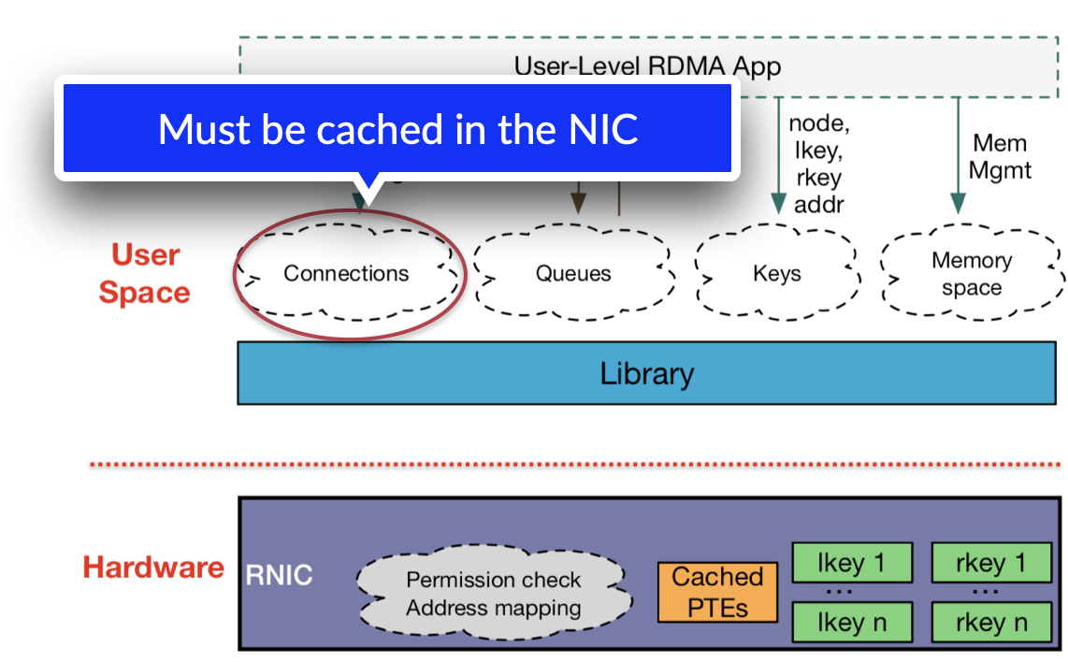
But connection information still cannot avoid
NIC must cache the connection information to accelerate the process
What if there is a cache miss?

Slide 91
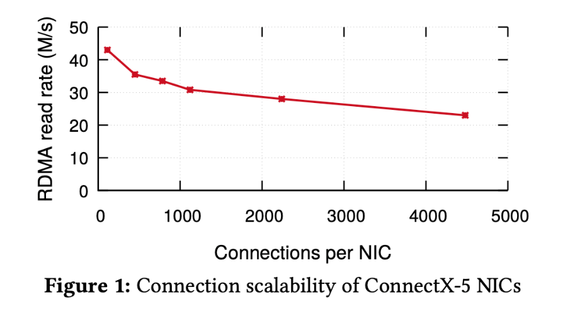
But connection information still cannot avoid
NIC must cache the connection information to accelerate the process
What if there is a cache miss?
Performance drop caused by cache misses
Extra PCIe READ for each request
1 -> 2
[1] credits: eRPC@NSDI’19

Slide 92
This leads to another extreme

Slide 93
Case study: FaSST@OSDI16
RDMA provides an unreliable transport: unreliable datagram (UD)
Similar to UDP (consider traditional RDMA connection as TCP)
UD is scalable:
No connection information is kept at the NIC
Drawbacks of UD:
No reliability guarantee
Only supports two-sided RDMA
Two-sided RDMA is sufficient for RPC: a key building block in distributed systems!

Slide 94
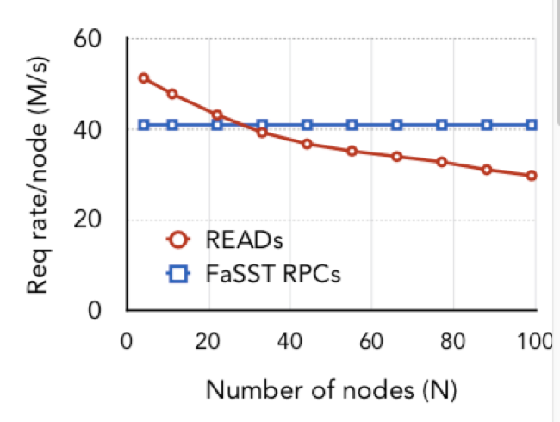
Case study: FaSST@OSDI16
RDMA provides an unreliable transport: unreliable datagram (UD)
Similar to UDP (consider traditional RDMA connection as TCP)
UD is scalable:
No connection information is kept at the NIC
Drawbacks of UD:
No reliability guarantee
Only supports two-sided RDMA
Two-sided RDMA is sufficient for RPC: a key building block in distributed systems!

Slide 95
Does no reliability a significant problem?
RDMA provides an unreliable transport: unreliable datagram (UD)
Similar to UDP (consider traditional RDMA connection as TCP)
UD is scalable:
No connection information is kept at the NIC
Drawbacks of UD:
No reliability guarantee
Only supports two-sided RDMA

Slide 96
Not that significant: RDMA rarely drop packets
#1. RDMA requires the link-layer to guarantee reliability
e.g., RoCE uses packet flow control to avoid switch drop packets
#2. The semantic of RPC simplifies the packet drop checking
The remote end must send a reply
If timeout, treat the packet as loss

Slide 97
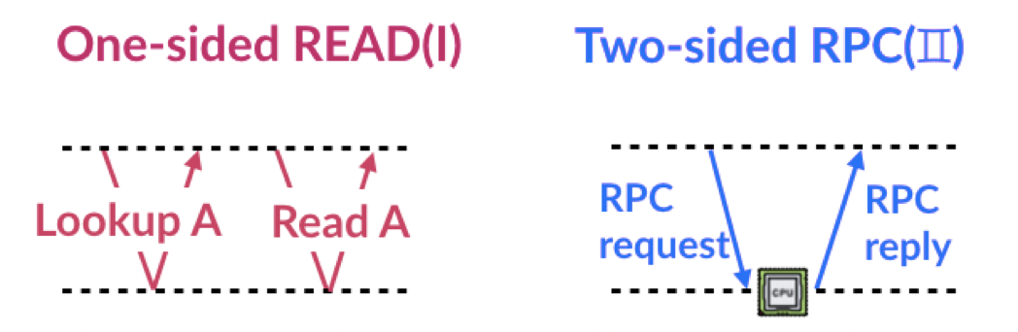
Other benefits of using RPC
Reduced network roundtrips
Compared to one-sided RDMA
Example: implement a key-value store using FaRM’s approach

Slide 98
Takeaway of RPC vs. one-sided RDMA
Not a hard conclusion!
Pros of one-sided
Energy efficient
Better (theoretical performance)
CPU bypassing
Cons of one-sided
Poor offloading semantic
Scalability issues
Not a hard conclusion!
Pros of two-sided
Easy programming
Scalable performance
Cons of two-sided
Low performance when scalability is not an issue
CPU overhead

Slide 99
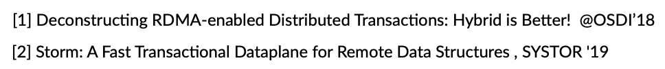
Trends of scalability of one-sided RDMA
New NICS are more scalable!
Partly not due to the increased SRAM
But a better cache management, NIC pipeline processing, increased PCIe bandwidth etc.
Example:
Connect-X5 (2017) scales to 80 all-to-all mappings[1,2], while Connect-X3 (2014) only scales to a few
Advanced RDMA transport:
Dynamic connect transport allows one QP to connect to different nodes

Slide 100
But the limited offloading semantic of RNIC is still a problem.

Slide 101
RDMA: limited functionalities
One-sided RDMA only supports simple READ/WRITE semantics
Distributed systems typically are more complex
Example: lookup in a key-value store still requires multiple one-sided roundtrips

Slide 102
Can RNIC do better?

Slide 103
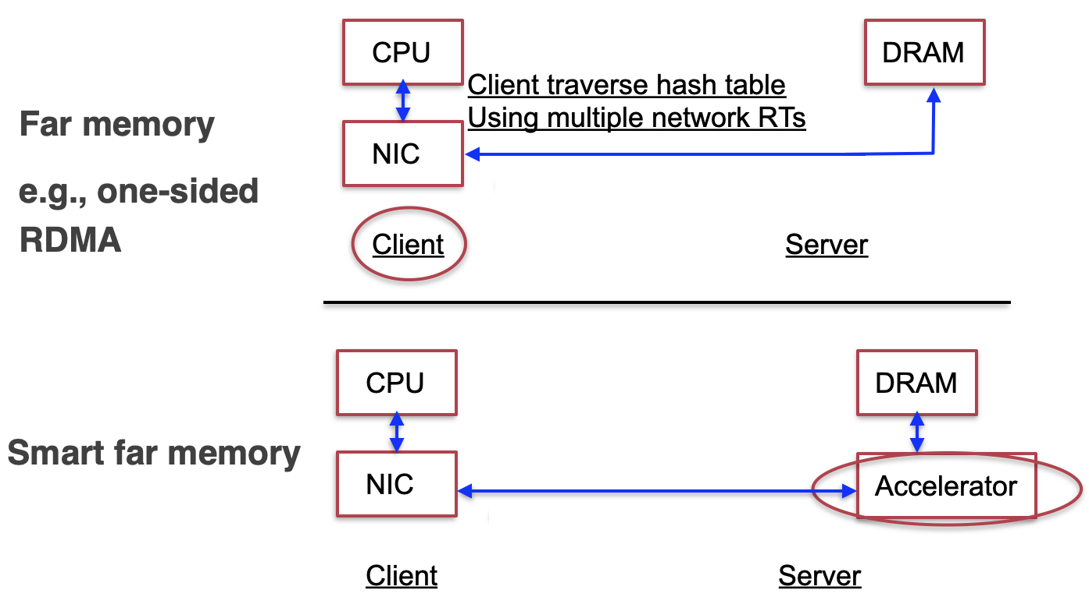
Being smart with SmartNICs

Slide 104
Overview of design space of SmartNIC
Provide more flexible (programmable) semantic on the NIC
What is the accelerator?
RDMA: ASIC -- only read/write
SmartNIC: FPGA, Arm SOC, MIPS, etc.
What is the programming abstraction?
Verbs (RDMA), C/C++, P4, etc.
Where to place the accelerator?
on-path vs. off-path

Slide 105
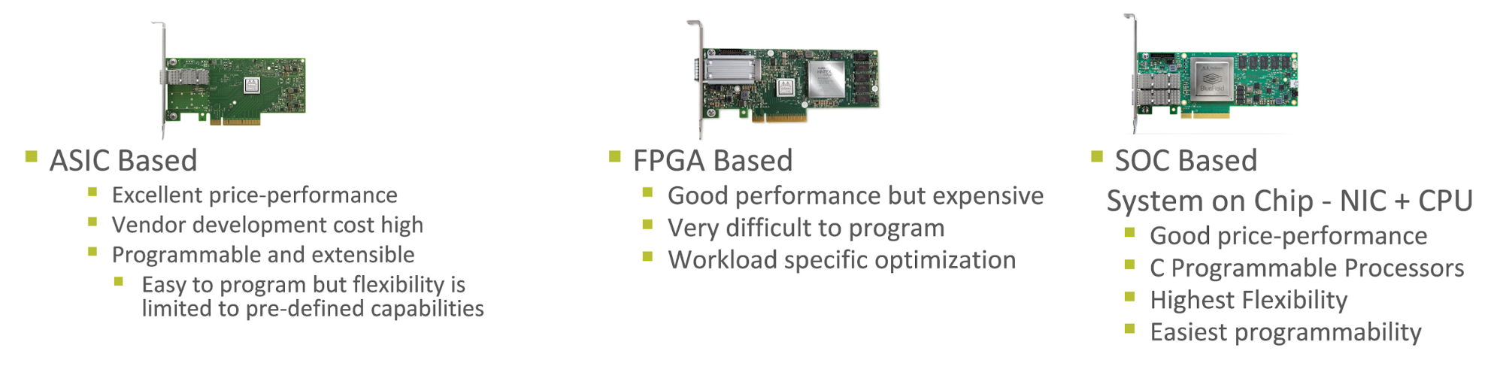
Overview of design space of SmartNIC
SmartNIC can have various computing units
Trade-off between performance & flexibility

Slide 106
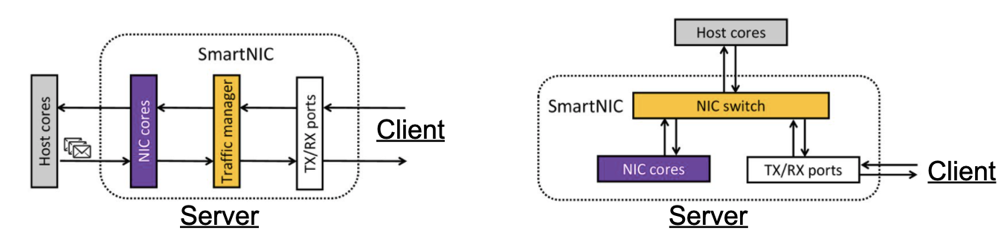
On-path vs. off-path for intercepting networking requests
Pros
Lower latency
Cons
No resource isolations
Pros
Clear resource isolation
Cons
Latencies added due to NIC switch

Slide 107
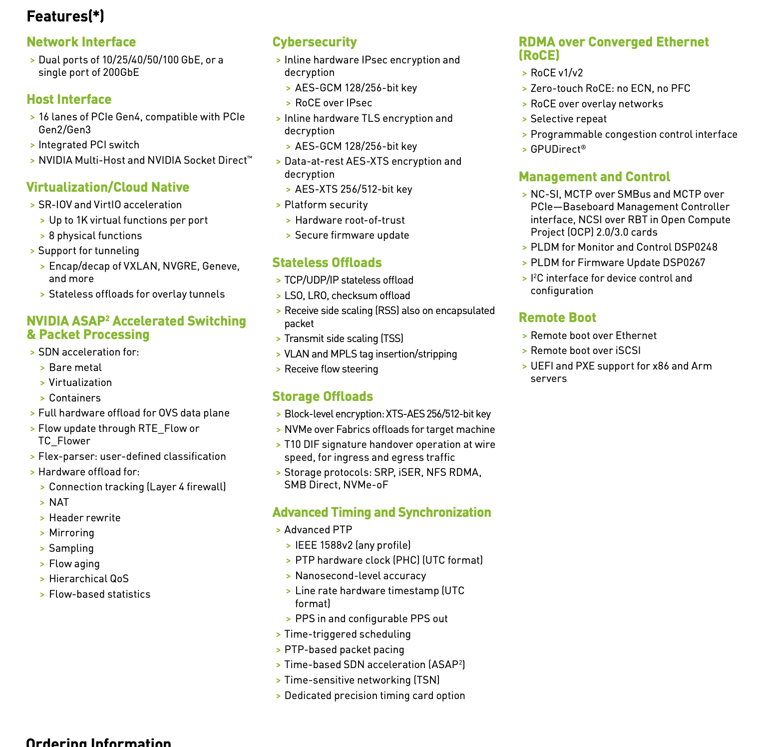
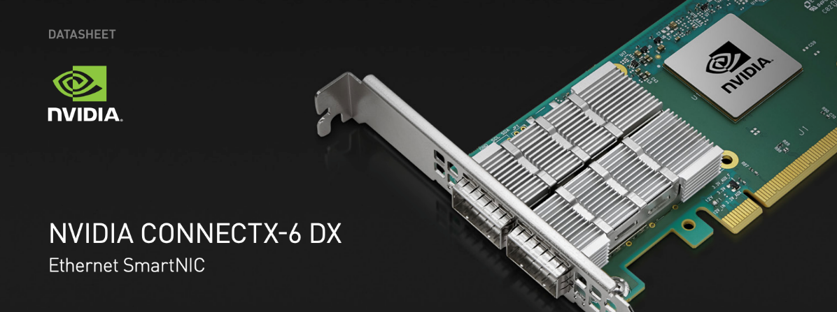
RDMA NICs can also be programmable

Slide 108
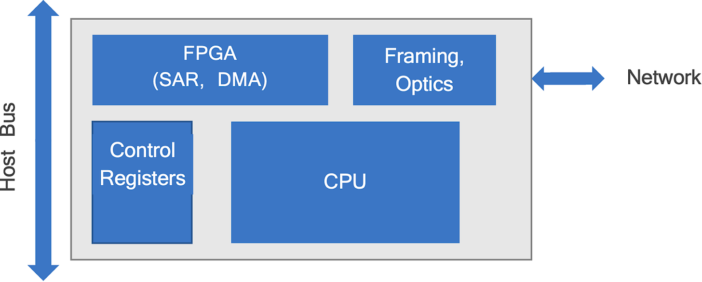
SmartNIC in 1990s: Support Innovation
Which Functions Belong to NICs? Which protocols are better?
The network protocols are evolving quickly (e.g., ATM or Ethernet? )
People use SmartNICs to evaluate different protocols quickly
Notes:
ATM: a network protocol
90年代的智能网卡是作为实验平台来使用的。当时的网络界百花齐放，有许多问题悬而未决。所以有一个可编程的网络设备可以方便地进行开发和实验。而到了2000年以后，很多问题得到了结果，以太网一统江湖。这个时候固化的网卡就占了上风

Slide 109
SmartNIC in 2010s+: Software-Defined Offloading
Networking Become Dynamic
Software-Defined Networking
Network virtualization
Heterogeneous Computation
Multicore CPU hits the Power Wall
Domain specific, higher performance (e.g., RDMA-enabled KVS)

Slide 110
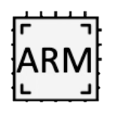

SmartNIC in 2010s+: Software-Defined Offloading
Host
VM/Container
VM
VM
NIC
DFS
KV-Store
DPDK
SDN
OVS
CPU
RoCE
TCP/IP
IPsec
NVMe-oF
Comp.
OVS
Encrypt.
Hashing
Dedup.
Ethernet
FPGA
SR-IOV
RAND
VirtIO-blk
Physical

Slide 111
Challenges in offloading
Costly communications between host and SmartNIC
The latency of PCIe is much higher than DRAM access
E.g., 1000ns vs. 100ns
Wimpy computing power due to energy restrictions
NIC’s on-board CPU is typically slower than the host

Slide 112
Brief summary of SmartNICs
Note that each type of the NIC can be on-path or off-path
 | Product | Programmable Unit | Programming Language | Performance | Flexibility | Cost
ASIC Based | Mellanox ConnectX-6 | \ | \ | High | Low | Low
FPGA Based | Xilinx U25 | FPGA | Hardware description language | Medium | High | High
SoC Based | Mellanox BlueField | Multicore Processor | Any | Low | Very high | Medium

Slide 113
An overview of SmartNIC performance

Slide 114

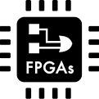
Deconstructing SmartNICs
Traffic control
Computing units
Traffic manager /
NIC switch
Multicore processor
Accelerator
FPGA
NIC core
Packet processing
TX/RX ports
DMA engine
L1 Cache
Domain specific
Onboard memory
Host communication
Packet buffer
DMA engine
Multi-queue
Scratchpad
L2/DRAM

Slide 115
Structural Difference between on-path & off-path NICs
Host cores
NIC switch
Host cores
NIC cores
Traffic manager
TX/RX ports
Traffic
Firmware
NIC cores
TX/RX ports
Full OS
Traffic
On-path SmartNIC
Off-path SmartNIC
10GbE LiquidIOII CN2350, 1.2GHz
25GbE Stingray PS225, 3.0GHz

Slide 116
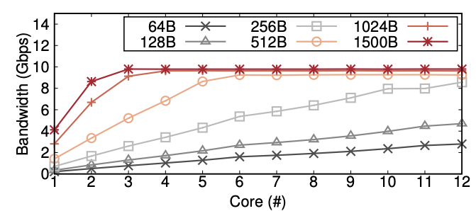
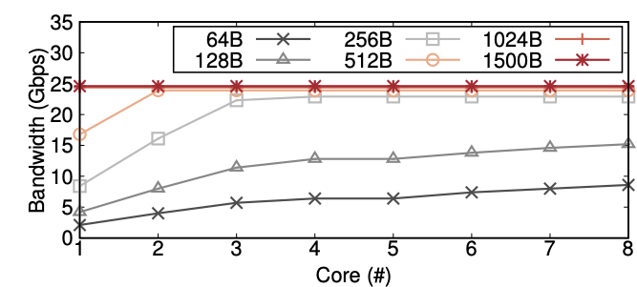
Packet Processing Performance
SmartNIC architecture collects taxes for the offloading power
What are the detailed costs?
Microbenchmark
Forwarding without any additional processing
Quantifies the default forwarding tax of SmartNICs
10GbE LiquidIOII CN2350, 1.2GHz
25GbE Stingray PS225, 3.0GHz
Notes:
Echo server

Slide 117
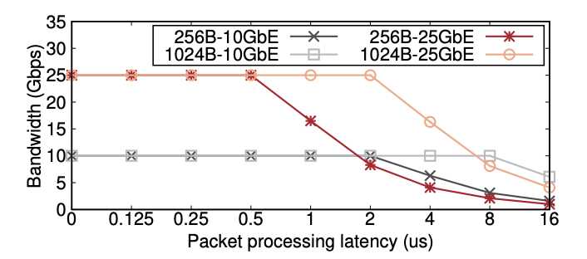
Processing Headroom
Using the same microbenchmark, except
Forwarding throughput as we introduce additional per-packet processing
Headroom is workload dependent and only allows for the execution of tiny tasks
Insights
Network incurs non-trivial tax on SmartNIC, and the request payload matters

Slide 118
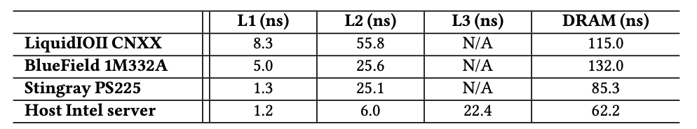
On-board DRAM
Like traditional server, SmartNIC also has memory hierarchy
L1 cache
Packet buffer
L2 cache
NIC local DRAM
Insight: avoid cache misses on SmartNICs
Notes:
就是working-set超过cache size的话，性能影响会很大，因为DRAM访问延迟高，而网卡的L2和host的L3差不多

Slide 119
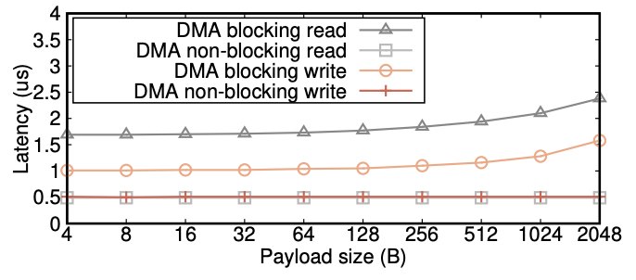
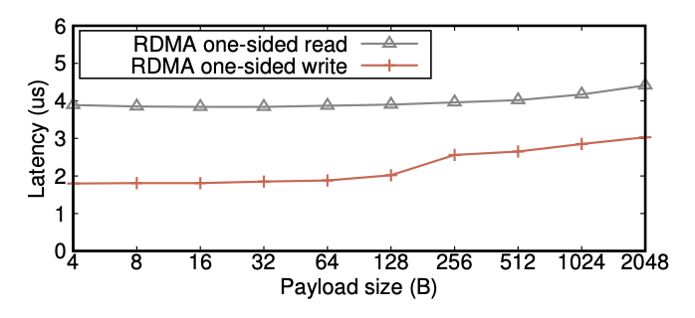
Host communication performance
Two ways
DMA over PCIe
Blocking
Non-blocking
RDMA Primitives (2X+ latency)
Insight
RDMA simplifies programming but at the cost of performance
DMA Latency on the 10GbE LiquidIO CN 2350
RDMA Latency on the 25GbE BlueField 1M332A

Slide 120
Brief Summury of on-path vs. off-path
 | On-path | Off-path
Programming interface | Low-level: RX/TX queue, packet buffer management, DMA engine, et. al; | Full Linux OS
How to offload | Add logic in the packet processing pipeline | Direct traffic to cores
Access host memory | PCIe DMA | RDMA
Limitation | Host traffic consume NIC cores | Higher latency to host memory

Slide 121
Case study: KV-Direct@SOSP’17

Slide 122

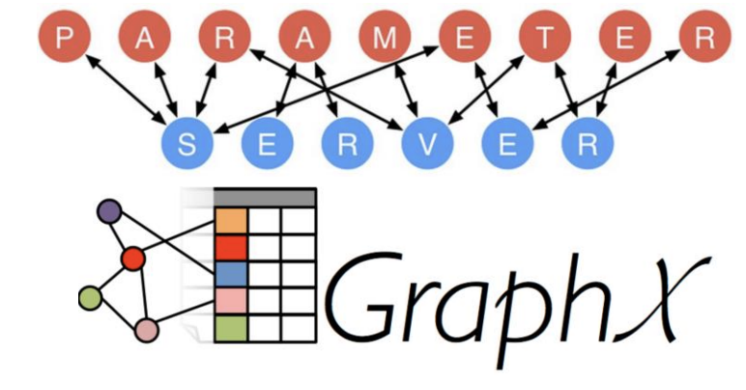
Key-Value Store in Data Centers
Web Cache
Shared Data Structure
Key Value
User ID Recent Tweets
SQL Query result
Session Browser cookies
Key Value
Graph node List of edges
Feature Weight
Shard Sequence number

Slide 123
Key-Value Store in Data Centers
Shared Data Structure
Design Goals
High throughput
Low tail latency
Write intensive
Vector operations
Atomic operations
Key Value
Graph node List of edges
Feature Weight
Shard Sequence number

Slide 124
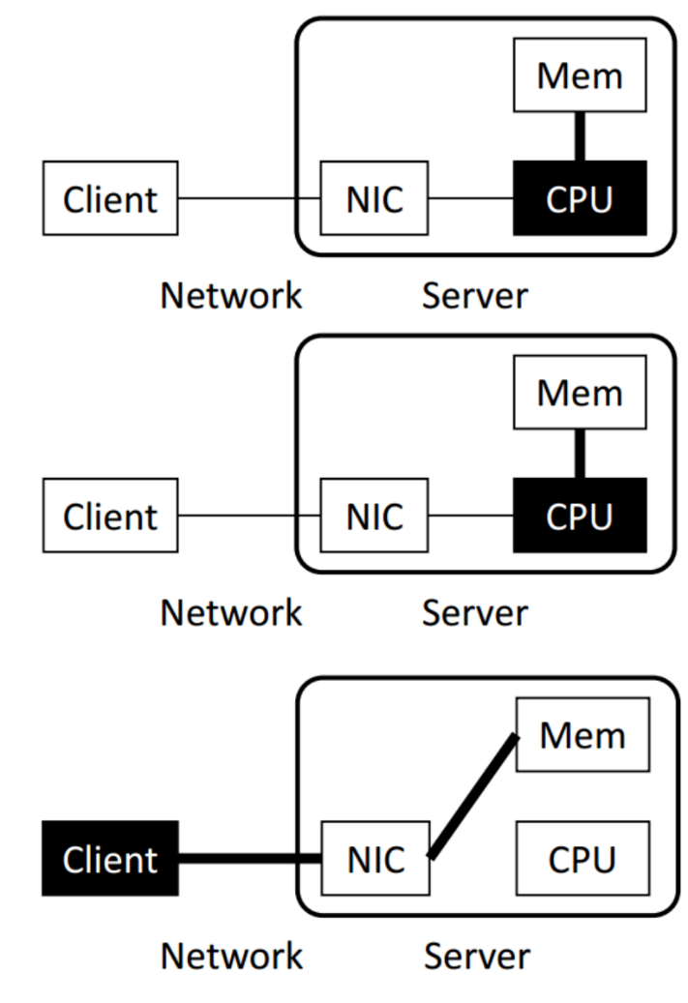
Key-Value Store Architectures
Software (Kernel TCP/IP)
Bottleneck: Network stack in OS
(~300 Kops per core)
Software (Kernel Bypass)
e.g. DPDK, mtcp, libvma, two-sided RDMA
Bottleneck: CPU random memory access and KV operation computation
(~5 Mops per core)
One-sided RDMA
Communication overhead: multiple round-trips per KV operation (fetch index, data)
Synchronization overhead: write operations

Slide 125
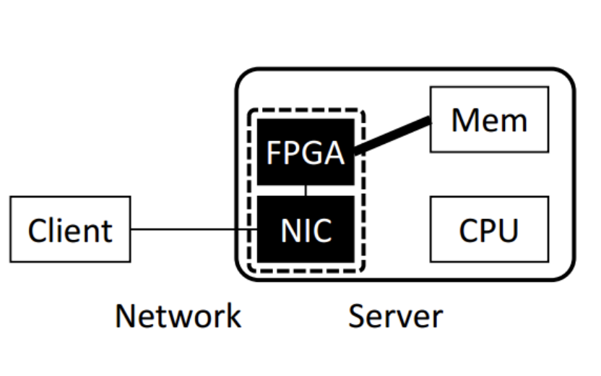
Key-Value Store Architectures
KV-Direct FPGA + NIC
Offload KV processing on CPU to Programmable NIC

Slide 126
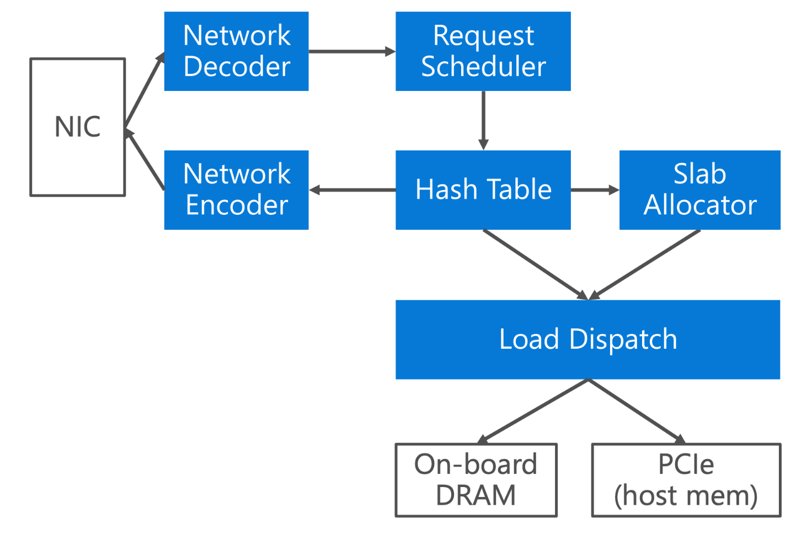
KV-Direct Architecture

Slide 127
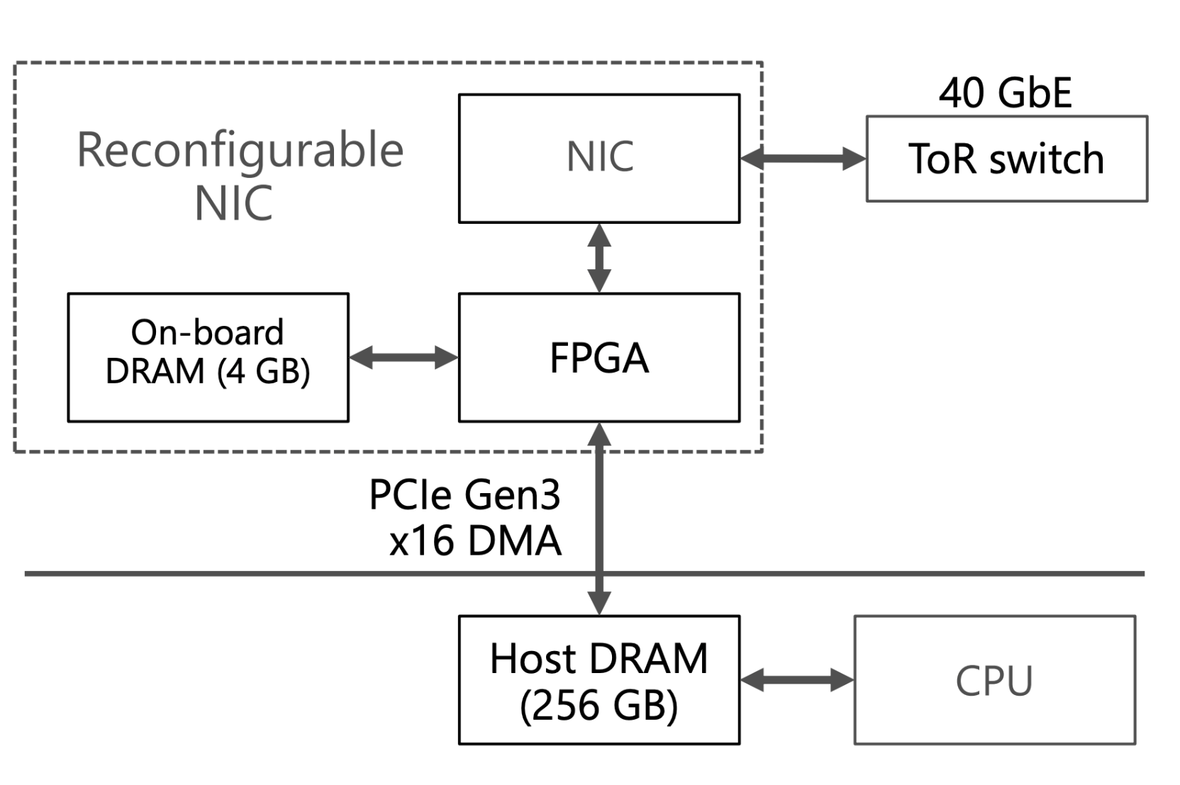
Performance Challenges
(Intel Stratix V)
Notes:
First, PCIe credit-based flow control constrains the number of in-flight requests for each DMA type.
Second, DMA read requires assigning a unique PCIe tag to identify DMA responses which may come out of order. The DMA engine in our FPGA only support 64 PCIe tags, further limiting our DMA read concurrency to 64 requests, which renders a throughput of 60 Mops.

Slide 128
Performance Challenges
Header overhead and limited parallelism
Be frugal on memory accesses
13 GB/s
120 Mops
Notes:
First, PCIe credit-based flow control constrains the number of in-flight requests for each DMA type.
Second, DMA read requires assigning a unique PCIe tag to identify DMA responses which may come out of order. The DMA engine in our FPGA only support 64 PCIe tags, further limiting our DMA read concurrency to 64 requests, which renders a throughput of 60 Mops.

Slide 129
Performance Challenges
Atomic operations have dependency:
PCIe latency hiding
1us delay
120 Mops

Slide 130
Performance Challenges
0.2us delay
100 Mops
Load dispatch
1us delay
120 Mops

Slide 131
Performance Challenges
60 Mops
0.2us delay
100 Mops
Client-side batching
Vector-type operation
1us delay
120 Mops

Slide 132
Design Principles
Minimize DMA requests per KV operation
Hide PCIe latency
Leverage throughput of both on-board and host memory
Offload simple client computation to server

Slide 133
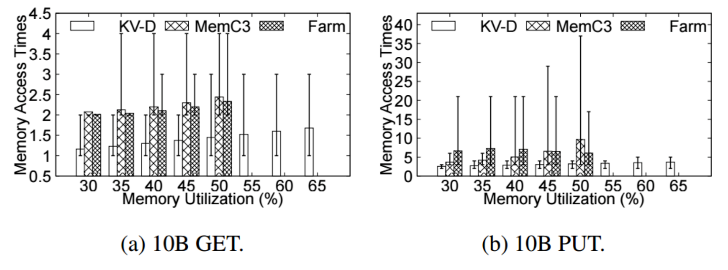
Minimize DMA requests per KV operation
Hash table: minimal access per GET & PUT
Cuckoo hashing : constant GET, sacrifice PUT
Log-structured memory: fast PUT, sacrifice GET
KV-Direct: Bucketized chaining: Close to 1 per GET, 2 per PUT

Slide 134
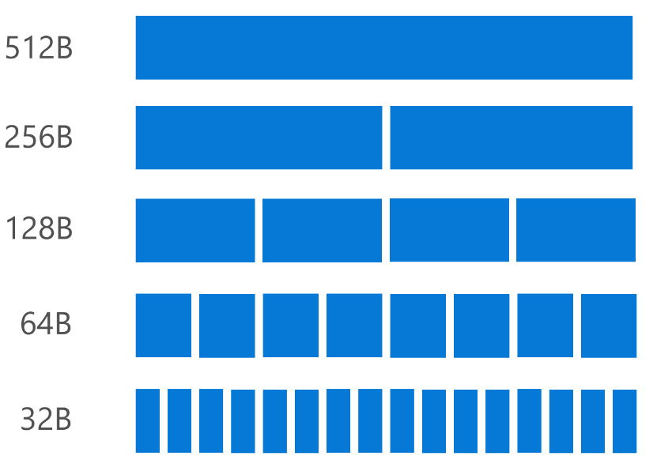
Minimize DMA requests per KV operation
Slab memory allocator
Main logic runs on the host
Cache free slab pool on the NIC
0.07 amortized DMA operations per (de)allocation

Slide 135
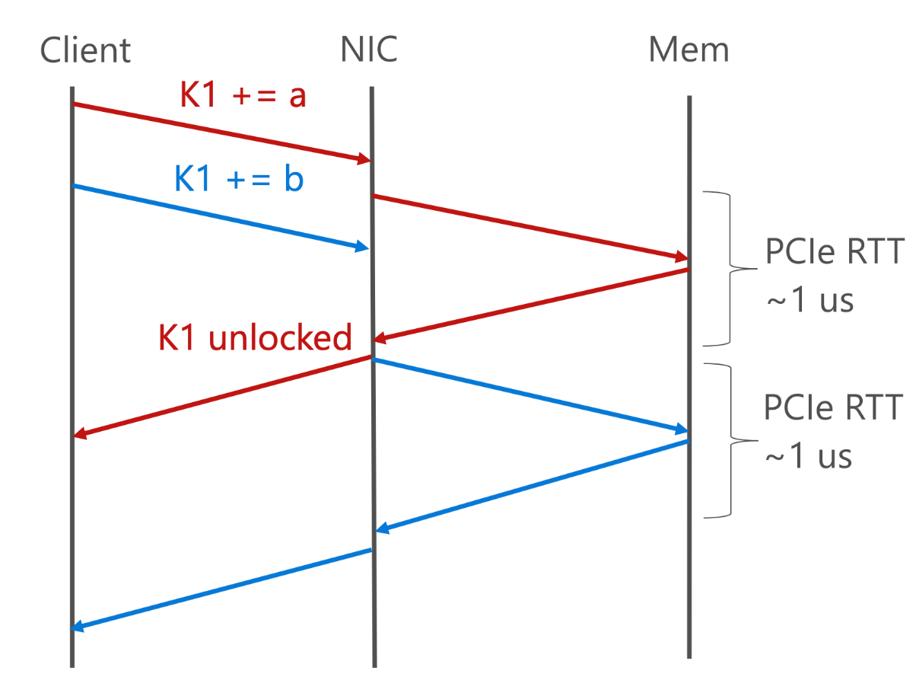
Hide PCIe Latency
Memory Dependency

Slide 136

Hide PCIe Latency
Reservation Station
Cache latest values

Slide 137

Hide PCIe Latency
Pipeline Stall

Slide 138

Hide PCIe Latency
Reservation Station
Cache latest values
Track inflight ops and their execution context

Slide 139

Hide PCIe Latency
Out-of-order Execution
191x single-key atomics, 20x long-tail workload

Slide 140

Leverage Throughput of Both Memory

Slide 141

Leverage Throughput of Both Memory
Load Dispatch = Cache + Load Balance

Slide 142

Evaluation

Slide 143
Detailed performance analysis of a SmartNIC

Slide 144



From RNIC SmartNIC: larger offloading design spaces
The central processing unit RDMA-capable NIC (RNIC) are NIC cores
ASIC that implements one-sided and two-sided operations (not programmable)
SmartNIC extends RNIC to support programmable capabilities
NIC cores
NIC cores
SoC cores & mem
Network
Network
DRAM
One-sided
Two-sided
One-sided
Two-sided
App-specific
computation
Host DRAM
Host DRAM
Notes:
The limitation of RDMA is that its offloading options are restricted by the NIC ASIC cores.In response to this, modern NICs are extending the RDMA NIC to equip with programmable computing units, such as SoC cores. These units enable developers to offload more complex application logic onto the NIC.

Slide 145
From one-sided RDMA to SmartNIC, does it help?
SmartNIC: RNIC equip with a programmable SoC (RNIC + SoC)
Back to our initial case study: Get(K) -> V in key-value storage
We can use the programmability of SmartNIC to execute the Get() w/o amplification
Get(K)
Index
V
Get(K)
V
Client
Client
RNIC
RNIC
RDMA
READ
RDMA
READ
SEND
RECV
RNIC
RNIC
Server
Server
Index
V
SoC
Host DRAM
Index
Values
Host DRAM
Index
Values
Notes:
With the help of SoC, it is possible to offload the more complex KVS logic to the NIC, addressing the network amplification problem of one-sided RDMA, while avoid the CPU bottleneck of the two-sided RDMA (click).
Specifically, we can send the request to the SmartNIC SoC to help execute the request.
.

Slide 146
From one-sided RDMA to SmartNIC, does it help?
Our (naïve) SmartNIC-KVS is 14% of the RDMA-KVS !! (workload: YCSB-C (100% Get))
RDMA-KVS: DrTM-KV [SOSP’15]
SmartNIC-KVS: leverage SEND/RECV to offload Get to the NIC SoC
Get(K)
V
Client
RNIC
SEND
RECV
RNIC
Server
Index
V
SoC
DrTM-KV
SmartNIC-KV
Host DRAM
Index
Values
Notes:
However, our initial results show that when we offload the request to the SoC, SmartNIC-accelerated KVS can only achieve 14% of the performance of RDMA-accelerated KVS.
The problem can be the weak computation power of SoC or the hidden performance tax introduced by the SmartNIC hardware.

Slide 147

SmartNIC is more complex than we have thought
Many SmartNIC architectures exist (More complex than we thought)
We focus on off-path SmartNIC, a widely used SmartNIC architecture
Representative example: NVIDIA Bluefield-2 SmartNIC
Discovered via exp + doc
NIC cores
SoC cores & mem
NIC cores
SoC cores & mem
PCIe
Switch
Cache
PCIe1
DRAM
DRAM
PCIe0
Cache
Host DRAM
Host DRAM
Notes:
By examining the usually incomplete documentation of SmartNICs and conducting extensive evaluations (click), we discovered that the hardware units of SmartNICs are much more complex than we had previously thought. If developers do not carefully consider these factors, they may encounter unexpected performance anomalies.
Specifically, the SmartNIC doesn't simply add the SoC to it. The SoC is bridged with the NIC ASIC cores with a PCIe switch, where there are two PCIe channels linked the NIC cores and switch and the switch with the host together. Meanwhile, the SoC itself is also complex, with memory hierarchies and some accelerators.
Note that the study primarily focus on the off-path SmartNIC.

Slide 148

Our work: the most comprehensive characterization on SmartNIC
Existing studies exist^{[1][2][3]}, which provides valuable insights
The mostly focus on the offloading computation power of the SmartNIC
A known takeaway is that: SmartNIC’s SoC cores are wimpier than the host
 | L1 | L2 | L3 | DRAM
SoC | 4x | 4x | N/A | 2x
Host | 1x | 1x | 1x | 1x
Cache
Memory access speed ^{[1]} (lower is better)
Focus of existing work
DRAM
Benchmark | SoC | Host
Multi-core Coremark | 0.2x | 1x
Single-core Coremark | 0.5x | 1x
DPDK hash_perf | 0.3x | 1x
DPDK readwrite_lf_perf | 0.3x | 1x
[1] Offloading distributed applications onto smartnics using ipipe. SIGCOMM’19
[2] Performance characteristics of the bluefield-2 smartnic, arXiv
[3] A dbms-centric evaluation of bluefield dpus on fast networks. ADMS’22
CPU scores^{[1]} (higher is better)
148
Notes:
There have been valuable measurement studies in the literature that analyze the performance characteristics of SmartNICs. Most of them focus on the SmartNIC's programmable computing capabilities.
A well-known finding is that the computing capability of SmartNICs is weak except for the limited accelerators. This observation is unlikely to change due to the power constraints of the NIC. Therefore, we take the weak computing power of SoC as a premise of our study.

Slide 149

Our work: the most comprehensive characterization on SmartNIC
An important (and basic) component of NIC: communication, is not well explored
The communication paths of SmartNIC are more complex than other NICs
Path #1: Client → NIC → Host memory
Network
Traditional NICs (RDMA or non-RDMA)
Notes:
However, the communication performance features of SmartNIC have not been well-explored, which is actually an essential functionality of a network device. So understanding them is definitely important.
The communication path of SmartNIC is much more complex than traditional NICs. Specifically, traditional NICs only provide a single communication path to the system, which connects the network traffic to the host CPU and vice versa.

Slide 150
Our work: the most comprehensive characterization on SmartNIC
An important (and basic) component of NIC: communication, is not well explored
The communication paths of SmartNIC are more complex than other NICs
Path #1: Client → NIC → Host memory
Network
SmartNIC
Notes:
SmartNIC also provides this capability.

Slide 151
Our work: the most comprehensive characterization on SmartNIC
An important (and basic) component of NIC: communication, is not well explored
The communication paths of SmartNIC are more complex than other NICs
Path #1: Client → NIC → Host memory
Network
Path #2: Client → NIC → SoC memory
SmartNIC
Notes:
Meanwhile, SmartNIC enables more paths, including communicating with the on-board SoC memory and cores, (click)

Slide 152
Our work: the most comprehensive characterization on SmartNIC
An important (and basic) component of NIC: communication, is not well explored
The communication paths of SmartNIC are more complex than other NICs
Path #1: Client → NIC → Host memory
Network
Path #2: Client → NIC → SoC memory
Path #3: SoC memory ←→ host memory
SmartNIC
Notes:
and the SoC can further communicate with the host, and vice versa.

Slide 153

Our work: the most comprehensive characterization on SmartNIC
An important (and basic) component of NIC: communication, is not well explored
The communication paths of SmartNIC are more complex than other NICs
Path #1: Client → NIC → Host memory
Network
Path #2: Client → NIC → SoC memory
Path #3: SoC memory ←→ host memory
Performance characterization on all them!
SmartNIC
Notes:
Characterizing these paths are the focus of this work.

Slide 154
What do we characterize ?
SmartNIC hardware implication to the communication performance
Design guideline on building systems with SmartNICs
Notes:
More specifically, our characterization aims to answer two specific questions by measuring the performance of off-path SmartNICs:
What is the performance implication of the off-path SmartNIC hardware architecture?
Given these implications, how can system developers better utilize the SmartNIC?

Slide 155



Finding 1. SmartNIC < RNIC for path #1
Primitives evaluated
Client
The path #1 is long on the SmartNIC
Due to the intervention of PCIe switch
The one-way switch pass latency (300ns) is non-trivial for microsecond-scale computing
READ
WRITE
SEND/RECV
SoC
Host
Evaluation setup:
ConnectX-6 (RNIC) vs. Bluefield -2 (SmartNIC)
Both NICs use the same NIC cores
Latency (us)
WRITE
Payload: 64B
RNIC vs. SmartNIC
Notes:
Our first finding is that extending the RNIC to a SmartNIC will slow down path 1 in terms of latency and throughput.
This is because extra hardware components, i.e., the SmartNIC's internal PCIe and PCIe switch, are added to the critical path of each network packet process.
Our empircial results show that passing them will increase request latency by approximately 300ns. This delay is significant given the low latency of RNIC, which operates on the microsecond scale.

Slide 156

Finding 2. Path #2 is fast except for S/R
Primitives evaluated
Client
Communication with the SoC is faster except for the SEND/RECV (S/R)
Due to the reduced PCIe pass (i.e., PCIe0)
SEND/RECV is bottlenecked by the SoC cores
SoC
READ
WRITE
S/R
Host
Evaluation setup:
ConnectX-6 (RNIC) vs. Bluefield -2 (SmartNIC)
Both NICs use the same NIC cores
Path #2
Latency (us)
WRITE
Path #1
Payload: 64B
Fast interconnect
other than PCIe
RNIC vs. SmartNIC
Notes:
Compared to Path #1, Path #2 has much better RDMA performance, except for send/recv, which is bottlenecked by the weak SoC computing power.
Path #2 is faster because it omits passing one PCIe channel from the switch to SoC. Specifically, the PCIe switch directly links to the SoC with a faster internal connection other than PCIe, thanks to the close packaging of the hardware.

Slide 157

Finding 3. Anomalies exist paths involving SoC
Client
Example. Degraded bandwidth (for READ) with large data transfer
Observation: SoC supports a smaller PCIe MTU than host
Result: more PCIe packets processed, may cause HoL
Advice: proactively segmented large READ
READ
READ
SoC
Host
 | Host | SoC
PCIe MTU | 512B | 128B
Bandwidth (Gbps)
Suspect meet HoL
PCIe packets
transferred
Notes:
Although Path 2 is faster due to the closer package of SoC and NIC, the weaker hardware of SoC introduces anomalies even to packets not directly processed by the SoC cores.
For example, when issuing large RDMA READs to SoC, we observe a performance collapse on Path 2. We suspect this is due to head-of-line blocking, as more PCIe packets need to be processed at the DMA engine for larger reads.
One may wonder why Path 1 doesn’t suffer from this phenomenon. This is because, due to the more powerful host CPU, Path 1 can support a 4X PCIe MTU compared to SoC. Consequently, Path 1 only requires processing one fourth of the PCIe packets, which is much smaller than Path 2.

Slide 158

Finding 4. Path #3 has trade-offs
Primitives evaluated
Client
Many alternatives to implement Path #3
The simplest (& easiest to use one): RDMA
Yet, RDMA needs to pass RNICs & PCIes
For networking support
READ
WRITE
SEND/RECV
SoC
Host
Evaluation setup:
ConnectX-6 (RNIC) vs. Bluefield -2 (SmartNIC)
Both NICs use the same NIC cores
Latency (us)
Higher latency than other paths
Notes:
Next, we will explore the performance features of path 3. Interestingly, SmartNIC provides several alternatives for path 3, and each alternative has different trade-offs.
The most straightforward option is to use RDMA to communicate between the host and SoC. However (click), this option has higher latency than the others, even though it doesn't go through the network.
Why? Because to support the RDMA protocol, packets must first come to the NIC core for processing, then be transferred back. The transfer is necessary for network protocol support, but the added cost is non-trivial.

Slide 159

Finding 4. Path #3 has trade-offs
Client → SoC → Host
Client
Path #2
200Gbps
RDMA, though simple, has two problems for Path #3
High latency due to additionally passes hardware units
Bandwidth interference to the others
SoC
Path #3
256Gbps
Host
Case study: file replication in LineFS [SOSP’21]
RDMA of path #3 overuses the PCIe bandwidth
What is the performance of path#2 + path#3?
Notes:
To make matters worse, RDMA can overuse the PCIe bandwidth between the PCIe switch and NIC. This occurs because a single unidirectional traffic will occupy the bidirectional bandwidth of PCIe. (click)
What anomaly maybe caused by this fact? Let's consider a typical offloading design, where the client offloads a piece of data to the SoC for processing, and then the SoC sends it out to the host. This design is adopted by the state-of-the-art SmartNIC-accelerated system. (click)
For the targeted application, a system requirement is to saturate the network bandwidth. However,this offloading design fails to do so.

Slide 160

Finding 4. Path #3 has trade-offs
Client → SoC → Host
Client
Path #2
200Gbps
RDMA, though simple, has two problems for Path #3
High latency due to additionally passes hardware units
Bandwidth interference to the others
SoC
Path #3
256Gbps
Host
Case study: file replication in LineFS [SOSP’21]
RDMA of path #3 overuses the PCIe bandwidth
Client
…
PCIe 1 & 2 bandwidth
Bi-directional: 256Gbps
NIC
Data passes PCIe1 twice
1. NIC → SoC
2. SoC → NIC
PCIe1
SoC
PCIe0
Path#2 + Path#3
Peak at 128Gbps!
Host
Notes:
From the more zoomed in graph, let's see what's happens. Under path 3, a single piece of data will pass the same PCIe link twice. This may seems not be a problem if the PCIe bandwidth is bi-directional. However, the SoC may concurrently issuing path 2 requests on the same link, so the performance interference happen and we can only achieve half of the PCIe link. (click)
On our evaluated NIC, it is 128Gbps, which is lower than the 200Gbps supported by the NIC.

Slide 161
Finding 4. Path #3 has trade-offs
DMA always
better?
DMA: another alternative for path #3
Unlike RDMA, the SoC has a DMA engine for path #3 (i.e., DOCA DMA)
DMA bypasses PCIe for communication between SoC and host
Path #3 (RDMA)
Path #3 (DMA)
Latency (us)
Notes:
Is there an alternative to Path 3? (click) Yes, the SoC provides a DMA primitive for communication between the SoC and the host. (click)
Using DMA bypasses the NIC core and its PCIe channels, resulting in lower latency and better PCIe utilization compared to RDMA.
But is DMA always better?

Slide 162
Finding 4. Path #3 has trade-offs
Primitives evaluated
Client
The engine capabilities of RDMA and DMA is different
RDMA engine (NIC) is more powerful than DMA engine (SoC)
So RDMA is faster for transferring small data
READ
WRITE
SoC
Host
Thpt (Mreqs/sec)
Path #3 (RDMA)
Path #3 (DMA)
RDMA is executed by the NIC
DMA is executed
by the SoC
Notes:
The problem of DMA is that it has a lower throughput (click), because it relies on the engines on the SoC for execution. Due to the weak capabilities of the SoC, the DMA engine on the SoC is orders of magnitude slower than the engines on the NIC cores, which are used by RDMA.
This results in a fundamental trade-off between throughput and latency for path 3.

Slide 163
Key takeaway of the above findings
Each communication path of SmartNIC is not perfect
Inferior performance or performance anomalies needs to take care
Path #1: Client → NIC → Host memory
Inferior performance vs. RNIC
Network
SmartNIC
Notes:
In summary, the key takeaway from our findings are as follows: the communication path of SmartNIC is not faster than its corresponding path in a dumb NIC, a performance tax paid to being smart. Furthermore, each path has performance anomalies that developers need to consider when using SmartNIC.
Regarding path #1, the hardware that supports programmability will make its critical path longer.

Slide 164
Key takeaway of the above findings
Each communication path of SmartNIC is not perfect
Inferior performance or performance anomalies needs to take care
Path #1: Client → NIC → Host memory
Path #2: Client → NIC → SoC memory
Network
Faster access
Anomalies, e.g., more PCIe packets
SmartNIC
Notes:
For path 2, although it is faster than path 1, it has anomalies such as using more PCIe packets. Note that there are more anomalies revealed in our paper.

Slide 165
Key takeaway of the above findings
Each communication path of SmartNIC is not perfect
Inferior performance or performance anomalies needs to take care
Path #1: Client → NIC → Host memory
Path #2: Client → NIC → SoC memory
Network
Path #3: SoC memory ←→ host memory
RDMA: poor PCIe utilization + high latency
DMA: poor throughput
SmartNIC
Notes:
For path 3, it is evident that neither RDMA nor DMA paths are perfect for achieving low latency and high throughput.

Slide 166
Back to our key-value store example
How to help?
Our characterization explains why naïve KVS on SmartNIC is slow
SoC has wimpy cores (known)
Path #3 is slow in terms of latency (RDMA) and throughput (DMA)
NIC cores are under-utilized on the SmartNIC
Which are much faster than the SoC
Get(K)
V
Client
RNIC
SEND
RECV
RNIC
Server
Index
V
SoC
Host DRAM
Index
Values
Notes:
Back to our previous exmaple,
our analysis shows why offloading a key-value store onto a SmartNIC is slow.
First, the computation power of the SoC is weak for processing key-value requests.
Second, the communication required to read the key-value store content, namely, path 3 is ineferior both in terms of throughput and latency. (click)
A more intriguing question to consider is how
we can improve the acceleration of key-value stores by using smartnics? (click)
We have made one key observation: the powerful NIC cores on the SmartNIC are underutilized, opens new design opportunities.

Slide 167
Observation: a single path is not optimal, but concurrency can help!
A single alternative does not utilize the full power of SmartNIC
E.g., Bottlenecked by slow SoC–DMA and SoC in our naïve KVS design
Observation: concurrently utilize the SmartNIC power
E.g., we can utilize the unused RNIC!
127M
Get(K)
V
Client
54M
RNIC
SEND
RECV
RNIC
Server
Index
V
8M
SoC
Host DRAM
RDMA KVS
SmartNIC KVS
SmartNIC KVS
+ RDMA
Index
Values
Notes:
More specifically, since a single communication path is unable to fully utilize the SmartNIC, we can take advantage of the unused resources on the SmartNIC to achieve better performance! (click)
For example, after saturating the SmartNIC SoC, we found that the NIC can still handle 127 million RDMA traffic for the key-value store.

Slide 168
More findings: concurrent path can better utilize SmartNIC
Concurrent = some clients issues Path #1 ops, other issues Path #2
Path #2
Path #1
Concurrent usage of Path #1 + Path #2
Observation: SmartNIC seems to reserve NIC cores for different paths
READ 0B Thpt (Mreqs/sec)
WRITE 0B Thpt (Mreqs/sec)
Notes:
Based on our observations, we further characterize the concurrent usage of communication paths of the SmartNIC.
First, if both clients use path #1 and path #2 alone, they would hit a a similar bottleneck. Nevertheless, if we dispatch the clients to different paths, they can typically achieve high throughput. (click) This also applies to RDMA READ and WRITE operations.
We suspect that the NIC internally reserves NIC cores for different paths so a concurrent usage can utilize both of them.

Slide 169
More findings: concurrent path can better utilize SmartNIC
Concurrent usage of Path #1 + Path #3
Typically, can achieve a higher bandwidth
But, we should take care of interference !
RDMA is not a good primitive for path #3
Path #1
Path #3* (DMA)
Perf. + Bandwidth
Interference
PCIe limit
Network limit
Path #3 (RDMA)
Path #1
Path 1
Path 2
Path 3
Path 3*
Path 1
+3
Path 1
+3*
Notes:
Moreover, concurrently using the internal and external of SmartNICs, namely, using path 1 and path 3 together achieves a better aggregrated bandwidth even higher than the network (click).
Note that we still need to take care of the network interference. RDMA is not a good choice due to the competition on the NIC core and NIC DMA for path 3.

Slide 170

A guideline on building systems with SnartNIC
Recap the key takeaways from our characterization
Single path: Inferior performance or performance anomalies
Concurrent paths: better performance
Our suggested guideline when given a user networked request (e.g., KVS get())
Request
With the help of our characterization
1. Derive alternatives
1.1 Optimize
2. Evaluate + Rank
3. Select + Combine
…
A#2
A#1
…
A#1
A#2
Opt. A#1
Opt. A#2
A1 A2 A3
SmartNIC
Notes:
That's the all characterization of our study. Based on it, we suggest utilize the SmartNIC as follows (click).
First, we need to derive different alternatives to implement a given user networked request. (click)
Afterward, we need to optimize each path with the help of our performance characterization. (click)
Then, evaluate and rank each alternative based on system requirements, e.g., latency and throughput. (click)
Finally, we greedyly combine different alternatives until the hardware resources of SmartNIC are saturated.

Slide 171
Distributed key-value storage Get() revisit
System requirements
Low host CPU usage, low latency & high throughput
Low host CPU utilization
1 + 2. Design alternatives (A1—A5) & optimize! :
+ Index cache
+ value cache
Client
RNIC
READ
READ
SEND
RECV
SEND
RECV
READ
READ
READ
READ
SEND/RECV
RNIC
Server
SoC
READ
READ
Host DRAM
A1
A2
A3
A4
A5
Notes:
Let's make a final revisit to our key-value store case.
The system requirement is low host CPU usage, low latency and high throughput.
We can see that SmartNIC enables many alternatives for a key-value store.
We won't talk about them in details due to the time constraints.

Slide 172
Evaluate different alternatives: throughput
The goal: low latency (when there is not so much client)
Offload KVS request on the SoC w/ caching has the lowerst latency
Latency
(us)
Client
RNIC
READ
READ
SEND
RECV
SEND
RECV
READ
READ
READ
READ
SEND/RECV
RNIC
Server
SoC
READ
READ
Host DRAM
A1
A2
A3
A4
A5
Notes:
Based on our guideline, we next rank each alternative with evaluations.
The lowest latency is achieved when all the keys and values are cached on the SoC because we can use one RTT to retrieve it with the help of offloading.

Slide 173
Evaluate different alternatives: throughput
The goal: high throughput (for a single SmartNIC-powered key-value store)
Peak Thpt (Mr/ssec)
Client
RNIC
READ
READ
SEND
RECV
SEND
RECV
READ
READ
READ
READ
SEND/RECV
RNIC
Server
SoC
READ
READ
Host DRAM
A1
A2
A3
A4
A5
Notes:
On the other hand, the highest throughput is achieved when using RDMA to access the cached key-value store entries on the SoC, mainly thanks to the efficiency of path #2 RDMA.

Slide 174

Rank, select and then combine
None of the approaches achieve both low latency & high throughput
A5(SEND/RECV) has the lowest latency, while A5(RDMA) has the highest throughput
Note that A5 is not always possible due to memory constraint of SoC
Whenever possible, choose A5 (SEND/RECV) for the lowest latency
If the SoC has been saturated, switch to A4 & A5 (RDMA)
Combine A4 + A5
Latency (us)
Evaluation setup: YCSB-C 100% Get( )
Notes:
Based on our rank, we choose A5 for our key-value store whenever possible, and switch to A4,the second best alternative if the value is not cached. Our results show much performance gain compared to a pure RDMA-KVS.

